Slide 1
Introduction to cell Biology
Chapters 4 and 5

Slide 2
Table of Contents
Chapter 4
Cell Structure and Function
Section 1 The History of Cell Biology
Section 2 Introduction to Cells
Section 3 Cell Organelles and Features
Section 4 Unique Features of Plant Cells

Slide 3
Objectives
Section 1 The History of Cell Biology
Chapter 4
Name the scientists who first observed living and nonliving cells.
Summarize the research that led to the development of the cell theory.
State the three principles of the cell theory.
Explain why the cell is considered to be the basic unit of life.

Slide 4
The Discovery of Cells
Section 1 The History of Cell Biology
Chapter 4
All living things are made up of one or more cells.
A cell is the smallest unit that can carry on all of the processes of life.

Slide 5
The Discovery of Cells, continued
Section 1 The History of Cell Biology
Chapter 4
Hooke
Robert Hooke discovered cells in slices of cork.
Leeuwenhoek
Anton van Leeuwenhoek was the first to observe living cells in microorganisms.

Slide 6
The Cell Theory
Section 1 The History of Cell Biology
Chapter 4
The cell theory states that all living organisms are made of one or more cells, cells are the basic units of structure and function, and cells come only from pre-existing cells.

Slide 7
The Cell Theory, continued
Section 1 The History of Cell Biology
Chapter 4
Cellular Basis of Life
All living things are made of organized parts, obtain energy from their surroundings, perform chemical reactions, change with time, respond to their environment, and reproduce.

Slide 8
Section 2 Introduction to Cells
Chapter 4
Objectives
Explain the relationship between cell shape and cell function.
Identify the factor that limits cell size.
Describe the three basic parts of a cell.
Compare prokaryotic cells and eukaryotic cells.
Analyze the relationship among cells, tissues, organs, organ systems, and organisms.

Slide 9
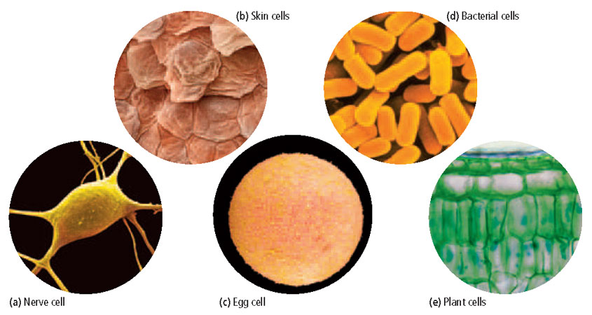
Section 2 Introduction to Cells
Chapter 4
Cell Diversity
Cell Shape
A cell’s shape reflects its function.

Slide 10
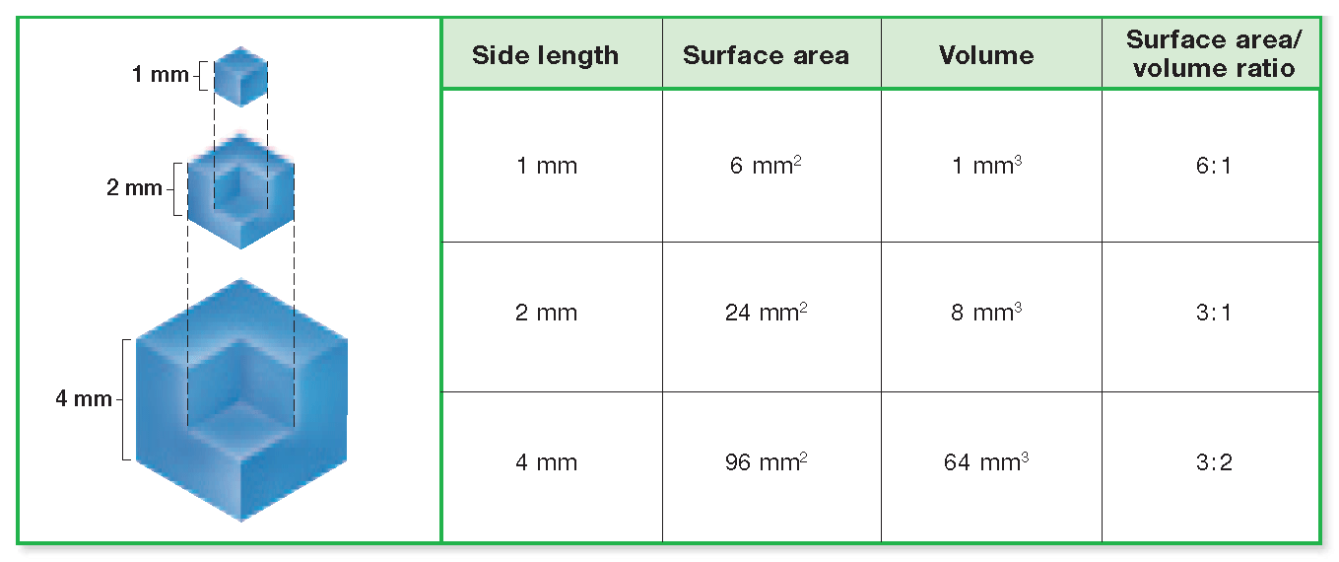
Section 2 Introduction to Cells
Chapter 4
Cell Diversity, Continued
Cell Size
Cell size is limited by a cell’s surface area–to-volume ratio.

Slide 11
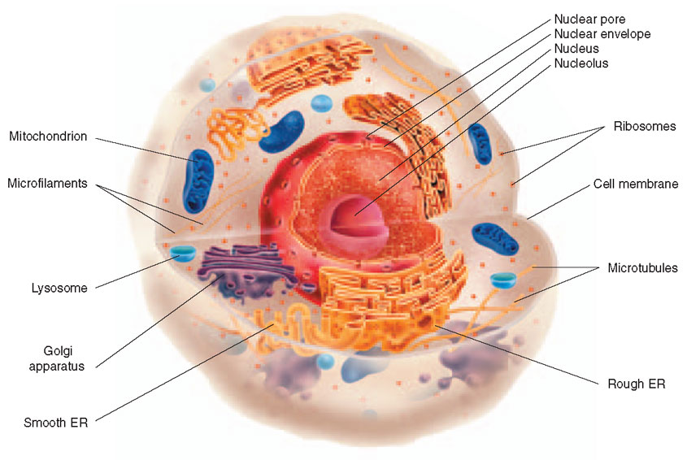
Section 2 Introduction to Cells
Chapter 4
Basic Parts of a Cell
The three basic parts of a cell are the plasma membrane, the cytoplasm, and the nucleus.

Slide 12
Section 2 Introduction to Cells
Chapter 4
Internal Organization of a Cell
Click below to watch the Visual Concept.
Visual Concept

Slide 13
Section 2 Introduction to Cells
Chapter 4
Basic Parts of a Cell, continued
Plasma Membrane
The cell’s outer boundary, called the plasma membrane (or the cell membrane), covers a cell’s surface and acts as a barrier between the inside and the outside of a cell.

Slide 14
Section 2 Introduction to Cells
Chapter 4
Basic Parts of a Cell, continued
Cytoplasm
The region of the cell that is within the plasma membrane and that includes the fluid, the cytoskeleton, and all of the organelles except the nucleus is called the cytoplasm.

Slide 15
Section 2 Introduction to Cells
Chapter 4
Basic Parts of a Cell, continued
Nucleus
The nucleus is a membrane-bound organelle that contains a cell’s DNA.

Slide 16
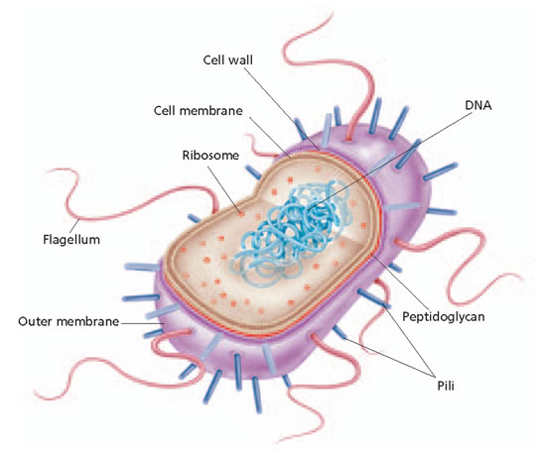
Section 2 Introduction to Cells
Chapter 4
Two Basic Types of Cells
Prokaryotes
Prokaryote cells lack a nucleus and membrane-bound organelles.

Slide 17
Section 2 Introduction to Cells
Chapter 4
Two Basic Types of Cells, continued
Eukaryotes
Eukaryote cells have a nucleus and membrane-bound organelles.

Slide 18
Section 2 Introduction to Cells
Chapter 4
Comparing Prokaryotes and Eukaryotes
Click below to watch the Visual Concept.
Visual Concept

Slide 19
Section 2 Introduction to Cells
Chapter 4
Cellular Organization
In multicellular eukaryotes, cells organize into tissues, organs, organ systems, and finally organisms.

Slide 20
Section 3 Cell Organelles and Features
Chapter 4
Objectives
Describe the structure and function of a cell’s plasma membrane.
Summarize the role of the nucleus.
List the major organelles found in the cytosol, and describe their roles.
Identify the characteristics of mitochondria.
Describe the structure and function of the cytoskeleton.

Slide 21
Section 3 Cell Organelles and Features
Chapter 4
Plasma Membrane
Membrane Lipids
Cell membranes consist of a phospholipid bilayer.

Slide 22
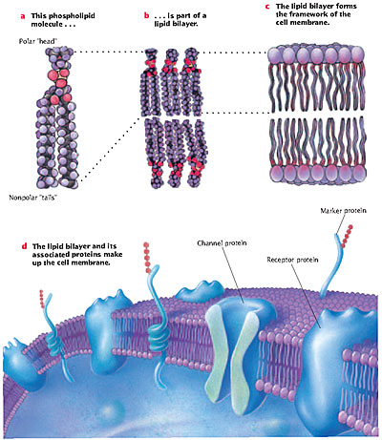
Structure of Lipid Bilayer
Section 3 Cell Organelles and Features
Chapter 3

Slide 23
Section 3 Cell Organelles and Features
Chapter 4
Cell Membrane

Slide 24
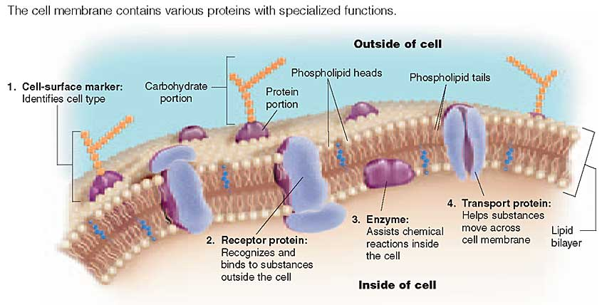
Section 3 Cell Organelles and Features
Chapter 4
Plasma Membrane, continued
Membrane Proteins
Cell membranes often contain proteins embedded within the phospholipid bilayer.

Slide 25
Section 3 Cell Organelles and Features
Chapter 4
Plasma Membrane, continued
Fluid Mosaic Model
The fluid mosaic model states that the phospholipid bilayer behaves like a fluid more than it behaves like a solid.

Slide 26
Section 3 Cell Organelles and Features
Chapter 4
Nucleus
The nucleus directs the cell’s activities and stores DNA.

Slide 27
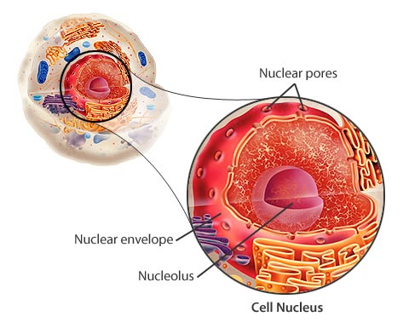
Section 3 Cell Organelles and Features
Chapter 4
Nucleus of a Cell

Slide 28
Section 3 Cell Organelles and Features
Chapter 4
Nucleus, continued
Nuclear Envelope
The nucleus is surrounded by a double membrane called the nuclear envelope.

Slide 29
Section 3 Cell Organelles and Features
Chapter 4
Nucleus, continued
Nucleolus
The nucleolus is the place where DNA is concentrated when it is in the process of making ribosomal RNA.

Slide 30
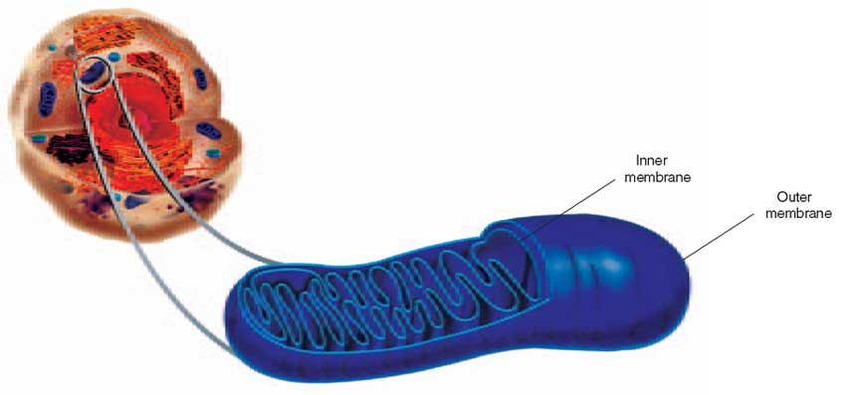
Section 3 Cell Organelles and Features
Chapter 4
Mitochondria
Mitochondria harvest energy from organic compounds and transfer it to ATP.

Slide 31
Section 3 Cell Organelles and Features
Chapter 4
Mitochondrion

Slide 32
Section 3 Cell Organelles and Features
Chapter 4
Ribosomes
Ribosomes are either free or attached to the rough ER and play a role in protein synthesis.

Slide 33
Section 3 Cell Organelles and Features
Chapter 4
Ribosomes
Click below to watch the Visual Concept.
Visual Concept

Slide 34
Section 3 Cell Organelles and Features
Chapter 4
Endoplasmic Reticulum
The rough ER prepares proteins for export or insertion into the cell membrane.

Slide 35
Section 3 Cell Organelles and Features
Chapter 4
Endoplasmic Reticulum, continued
The smooth ER builds lipids and participates in detoxification of toxins.

Slide 36
Section 3 Cell Organelles and Features
Chapter 4
Endoplasmic Reticulum (ER) and Ribosomes
Click below to watch the Visual Concept.
Visual Concept

Slide 37
Section 3 Cell Organelles and Features
Chapter 4
Golgi Apparatus
The Golgi apparatus processes and packages proteins.

Slide 38
Section 3 Cell Organelles and Features
Chapter 4
Vesicles
Vesicles, including lysosomes (digestive enzymes) and peroxisomes (detoxification enzymes), are classified by their contents.

Slide 39
Section 3 Cell Organelles and Features
Chapter 4
Vesicles, continued
Protein Synthesis
The rough ER, Golgi apparatus, and vesicles work together to transport proteins to their destinations inside and outside the cell.

Slide 40
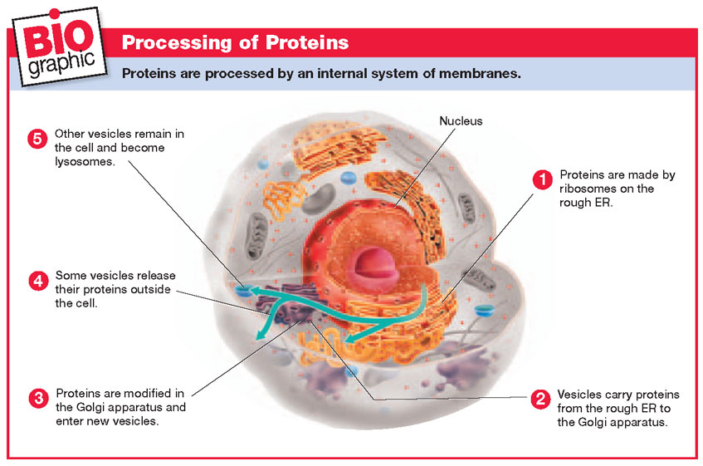
Processing of Proteins
Section 3 Cell Organelles and Features
Chapter 4

Slide 41
Section 3 Cell Organelles and Features
Chapter 4
Cytoskeleton
The cytoskeleton is made of protein fibers that help cells move and maintain their shape.
The cytoskeleton includes microtubules, microfilaments, and intermediate filaments.

Slide 42
Section 3 Cell Organelles and Features
Chapter 4
Cytoskeleton
Click below to watch the Visual Concept.
Visual Concept

Slide 43
Section 3 Cell Organelles and Features
Chapter 4
Cytoskeleton, continued
Cilia and Flagella
Cilia and flagella are hairlike structures that extend from the surface of the cell, where they assist in movement.

Slide 44
Section 3 Cell Organelles and Features
Chapter 4
Structure of Cilia and Flagella
Click below to watch the Visual Concept.
Visual Concept

Slide 45
Section 3 Cell Organelles and Features
Chapter 4
Cytoskeleton, continued
Centrioles
Centrioles consist of two short cylinders of microtubules at right angles to each other and are involved in cell division.

Slide 46
Section 4 Unique Features of Plant Cells
Chapter 4
Objectives
List three structures that are present in plant cells but not in animal cells.
Compare the plasma membrane,the primary cell wall, and the secondary cell wall.
Explain the role of the central vacuole.
Describe the roles of plastids in the life of a plant.
Identify features that distinguish prokaryotes, eukaryotes, plant cells, and animal cells.

Slide 47
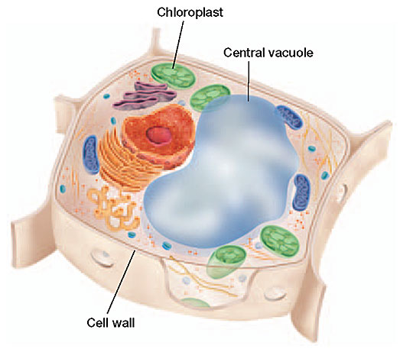
Section 4 Unique Features of Plant Cells
Chapter 4
Plant Cells
Plant cells have cell walls, central vacuoles, and plastids.

Slide 48
Section 4 Unique Features of Plant Cells
Chapter 4
Cell Wall
In plant cells, a rigid cell wall covers the cell membrane and provides support and protection.

Slide 49
Section 4 Unique Features of Plant Cells
Chapter 4
Parts of a Cell Wall
Click below to watch the Visual Concept.
Visual Concept

Slide 50
Section 4 Unique Features of Plant Cells
Chapter 4
Central Vacuole
Large central vacuoles store water, enzymes, and waste products and provide support for plant tissue.

Slide 51
Section 4 Unique Features of Plant Cells
Chapter 4
Plastids
Plastids store starch and pigments.
The chloroplast converts light energy into chemical energy by photosynthesis.

Slide 52
Section 4 Unique Features of Plant Cells
Chapter 4
Chloroplasts

Slide 53
Section 4 Unique Features of Plant Cells
Chapter 4
Comparing Cells
Prokaryotes, animal cells, and plant cells can be distinguished from each other by their unique features.

Slide 54
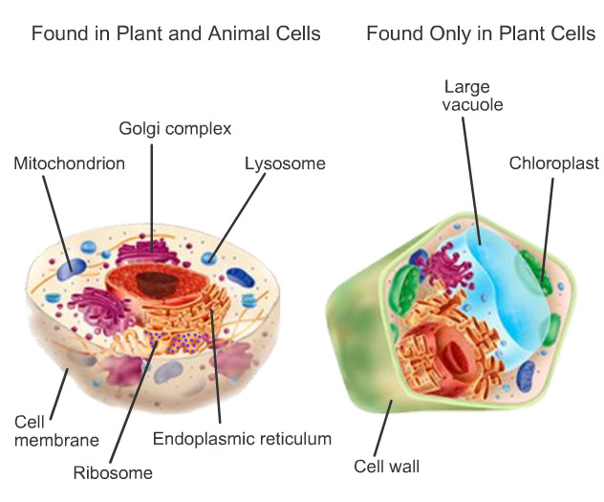
Section 4 Unique Features of Plant Cells
Chapter 4
Comparing Plant and Animal Cells

Slide 55
Objectives
Section 1 Passive Transport
Chapter 5
Explain how an equilibrium is established as a result of diffusion.
Distinguish between diffusion and osmosis.
Explain how substances cross the cell membrane through facilitated diffusion.
Explain how ion channels assist the diffusion of ions across the cell membrane.

Slide 56
Diffusion
Section 1 Passive Transport
Chapter 5
Passive transport involves the movement of molecules across the cell membrane without an input of energy by the cell.
Diffusion is the movement of molecules from an area of higher concentration to an area of lower concentration, driven by the molecules’ kinetic energy until equilibrium is reached.

Slide 57
Section 1 Passive Transport
Chapter 5
Concentration Gradient
Click below to watch the Visual Concept.
Visual Concept

Slide 58
Diffusion, continued
Section 1 Passive Transport
Chapter 5
Diffusion Across Membranes
Molecules can diffuse across a cell membrane by dissolving in the phospholipid bilayer or by passing through pores in the membrane.

Slide 59
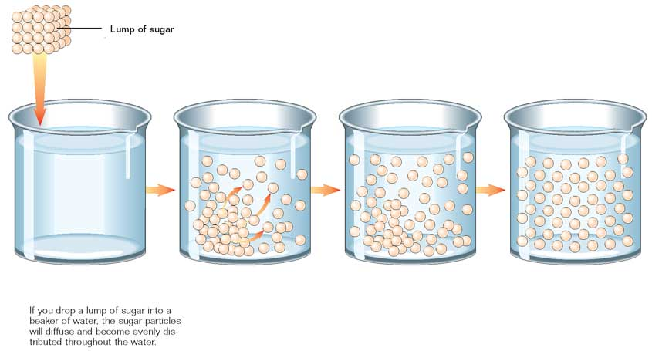
Diffusion
Section 1 Passive Transport
Chapter 5

Slide 60
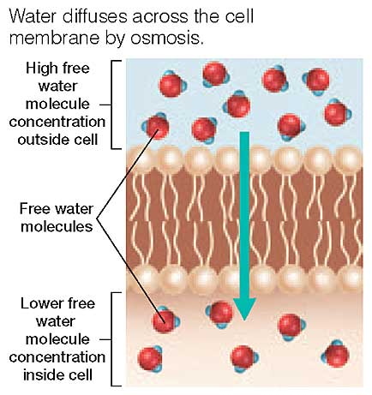
Osmosis
Section 1 Passive Transport
Chapter 5
Osmosis is the diffusion of water across a membrane.

Slide 61
Section 1 Passive Transport
Chapter 5
Osmosis
Click below to watch the Visual Concept.
Visual Concept

Slide 62
Osmosis, continued
Section 1 Passive Transport
Chapter 5
Direction of Osmosis
The net direction of osmosis is determined by the relative solute concentrations on the two sides of the membrane.

Slide 63
Osmosis, continued
Section 1 Passive Transport
Chapter 5
Direction of Osmosis
When the solute concentration outside the cell is higher than that in the cytosol, the solution outside is hypertonic to the cytosol, and water will diffuse out of the cell.

Slide 64
Osmosis, continued
Section 1 Passive Transport
Chapter 5
Direction of Osmosis
When the solute concentrations outside and inside the cell are equal, the solution outside is isotonic, and there will be no net movement of water.

Slide 65
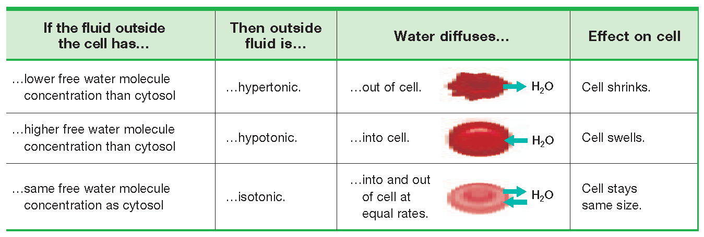
Hypertonic, Hypotonic, Isotonic Solutions
Section 1 Passive Transport
Chapter 5

Slide 66
Section 1 Passive Transport
Chapter 5
Comparing Hypertonic, Isotonic, and Hypotonic Conditions
Click below to watch the Visual Concept.
Visual Concept

Slide 67
Osmosis, continued
Section 1 Passive Transport
Chapter 5
How Cells Deal With Osmosis
To remain alive, cells must compensate for the water that enters the cell in hypotonic environments and leaves the cell in hypertonic environments.
Contractile vacuoles are organelles that regulate water levels in paramecia.

Slide 68
Facilitated Diffusion
Section 1 Passive Transport
Chapter 5
In facilitated diffusion, a molecule binds to a carrier protein on one side of the cell membrane.
The carrier protein then changes its shape and transports the molecule down its concentration gradient to the other side of the membrane.

Slide 69
Section 1 Passive Transport
Chapter 5
Passive Transport: Facilitated Diffusion

Slide 70
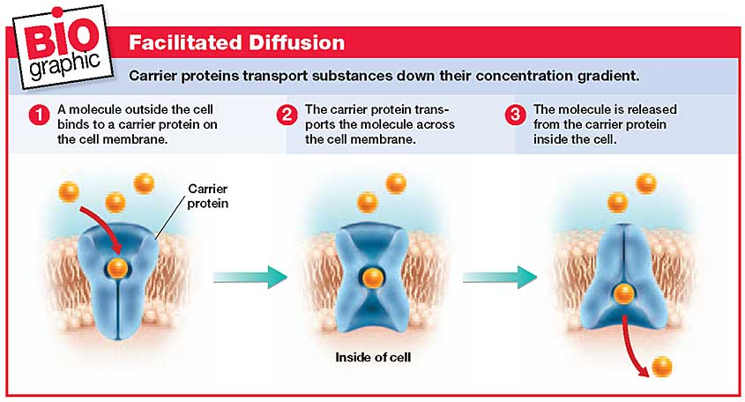
Facilitated Diffusion
Section 1 Passive Transport
Chapter 5

Slide 71
Diffusion Through Ion Channels
Section 1 Passive Transport
Chapter 5
Ion channels are proteins, or groups of proteins, that provide small passageways across the cell membrane through which specific ions can diffuse.

Slide 72
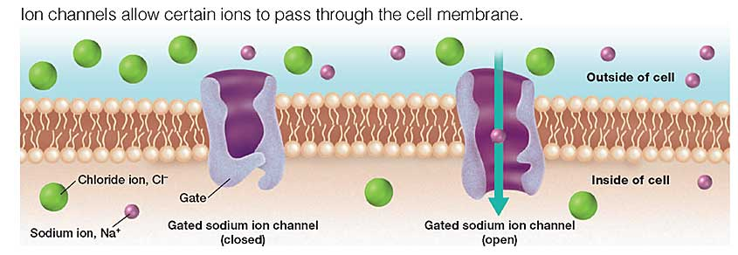
Ion Channels
Section 1 Passive Transport
Chapter 5

Slide 73
Section 1 Passive Transport
Chapter 5
Diffusion Through Ion Channels

Slide 74
Section 2 Active Transport
Chapter 5
Objectives
Distinguish between passive transport and active transport.
Explain how the sodium-potassium pump operates.
Compare endocytosis and exocytosis.

Slide 75
Section 2 Active Transport
Chapter 5
Cell Membrane Pumps
Active transport moves molecules across the cell membrane from an area of lower concentration to an area of higher concentration.
Unlike passive transport, active transport requires cells to expend energy.

Slide 76
Section 2 Active Transport
Chapter 5
Cell Membrane Pumps, continued
Some types of active transport are performed by carrier proteins called cell membrane pumps.

Slide 77
Section 2 Active Transport
Chapter 5
Cell Membrane Pumps, continued
Sodium-Potassium Pump
The sodium-potassium pump moves three Na⁺ ions into the cell’s external environment for every two K⁺ ions it moves into the cytosol.
ATP supplies the energy that drives the pump.

Slide 78
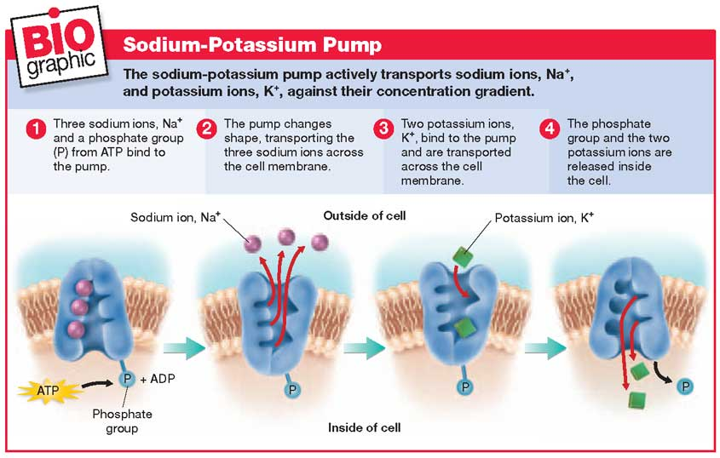
Sodium-Potassium Pump
Section 2 Active Transport
Chapter 5

Slide 79
Section 2 Active Transport
Chapter 5
Sodium-Potassium Pump

Slide 80
Section 2 Active Transport
Chapter 5
Movement in Vesicles
Endocytosis
In endocytosis, cells ingest external materials by folding around them and forming a pouch.
The pouch then pinches off and becomes a membrane-bound organelle called a vesicle.

Slide 81
Section 2 Active Transport
Chapter 5
Movement in Vesicles, continued
Endocytosis
Endocytosis includes pinocytosis, in which the vesicle contains solutes or fluids, and phagocytosis, in which the vesicle contains large particles or cells.

Slide 82
Section 2 Active Transport
Chapter 5
Endocytosis
Click below to watch the Visual Concept.
Visual Concept

Slide 83
Section 2 Active Transport
Chapter 5
Movement in Vesicles, continued
Exocytosis
In exocytosis, vesicles made by the cell fuse with the cell membrane, releasing their contents into the external environment.

Slide 84
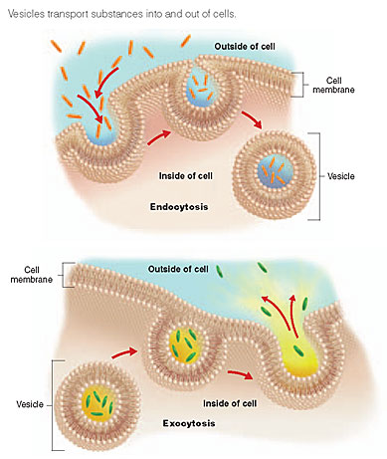
Endocytosis and Exocytosis
Section 2 Active Transport
Chapter 5

Slide 85
Osmosis
Section 1 Passive Transport
Chapter 5

Slide 86
Multiple Choice
Chapter 4
Standardized Test Prep
1. The eukaryotic nucleus houses all of the following except the
A. RNA
B. DNA
C. nucleolus
D. endoplasmic reticulum

Slide 87
Multiple Choice, continued
Chapter 4
Standardized Test Prep
1. The eukaryotic nucleus houses all of the following except the
A. RNA
B. DNA
C. nucleolus
D. endoplasmic reticulum

Slide 88
Multiple Choice, continued
Chapter 4
Standardized Test Prep
2. Which structure contributes to support and movement within a cell?
F. crista
G. cell wall
H. ribosome
J. microfilament

Slide 89
Multiple Choice, continued
Chapter 4
Standardized Test Prep
2. Which structure contributes to support and movement within a cell?
F. crista
G. cell wall
H. ribosome
J. microfilament

Slide 90
Multiple Choice, continued
Chapter 4
Standardized Test Prep
3. Which of the following statements about RNA is true?
A. RNA is found only in proteins.
B. RNA is found only in the nucleus.
C. RNA is found only in the cytoplasm.
D. RNA is found in the nucleus and cytoplasm.

Slide 91
Multiple Choice, continued
Chapter 4
Standardized Test Prep
3. Which of the following statements about RNA is true?
A. RNA is found only in proteins.
B. RNA is found only in the nucleus.
C. RNA is found only in the cytoplasm.
D. RNA is found in the nucleus and cytoplasm.

Slide 92
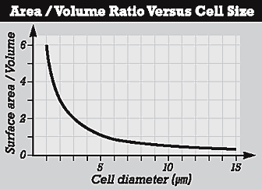
Chapter 4
Standardized Test Prep
Multiple Choice, continued
The graph below shows
the relationship between cell size and surface area–to–volume ratio. Use the graph below to answer
the questions that follow.
4. By what percentage does the surface area–to – volume ratio change when a cell grows from 1 to 2 µm in diameter?
F. 10 percent
G. 20 percent
H. 50 percent
J. 90 percent

Slide 93
Chapter 4
Standardized Test Prep
Multiple Choice, continued
The graph below shows
the relationship between cell size and surface area–to–volume ratio. Use the graph below to answer
the questions that follow.
4. By what percentage does the surface area–to – volume ratio change when a cell grows from 1 to 2 µm in diameter?
F. 10 percent
G. 20 percent
H. 50 percent
J. 90 percent

Slide 94
Chapter 4
Standardized Test Prep
Multiple Choice, continued
The graph below shows
the relationship between cell size and surface area–to–volume ratio. Use the graph below to answer
the questions that follow.
5. What is the maximum diameter that this cell could attain before the surface area–to-volume ratio would fall below 1?
A. 2 µm
B. 5 µm
C. 10 µm
D. 15 µm

Slide 95
Chapter 4
Standardized Test Prep
Multiple Choice, continued
The graph below shows
the relationship between cell size and surface area–to–volume ratio. Use the graph below to answer
the questions that follow.
5. What is the maximum diameter that this cell could attain before the surface area–to-volume ratio would fall below 1?
A. 2 µm
B. 5 µm
C. 10 µm
D. 15 µm

Slide 96
Chapter 4
Standardized Test Prep
Multiple Choice, continued
6. mitochondria : energy release :: ribosome :
F. cell support
G. protein synthesis
H. cellular digestion
J. cellular transport

Slide 97
Chapter 4
Standardized Test Prep
Multiple Choice, continued
6. mitochondria : energy release :: ribosome :
F. cell support
G. protein synthesis
H. cellular digestion
J. cellular transport

Slide 98
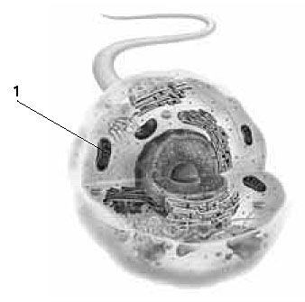
Chapter 4
Standardized Test Prep
Multiple Choice, continued
The figure below shows
a diagram of a cell. Use the figure to answer the
question that follows.
7. What is the function of the structure labeled 1?
A. to make ATP
B. to make proteins
C. to make carbohydrates
D. to move proteins through the cell

Slide 99
Chapter 4
Standardized Test Prep
Multiple Choice, continued
The figure below shows
a diagram of a cell. Use the figure to answer the
question that follows.
7. What is the function of the structure labeled 1?
A. to make ATP
B. to make proteins
C. to make carbohydrates
D. to move proteins through the cell

Slide 100
Chapter 4
Standardized Test Prep
Short Response
A cell’s shape is generally related to its function.
Skin cells are flat and platelike. Nerve cells have long extensions. Explain the relationship between the shape of skin and nerve cells and their function in the body.

Slide 101
Chapter 4
Standardized Test Prep
Short Response, continued
Answer:
Cell shape reflects the different functions of cells. For example, the long extensions of nerve cells allow these cells to receive and transmit nerve impulses in many directions. Also, the flat shape of skin cells suits their function of covering and protecting the surface of the body.

Slide 102
Chapter 4
Standardized Test Prep
Extended Response
Despite the diversity among cells, eukaryotic cells share many common features.
Part A Describe the structure and function of the organelles found in an animal cell.
Part B Summarize the differences that distinguish animal cells from bacteria and plant cells.

Slide 103
Chapter 4
Standardized Test Prep
Extended Response, continued
Answer:
Part A Answers may include the following: The nucleus holds and protects DNA; Mitochondria transfer energy to ATP; Ribosomes manufacture proteins; The ER functions as an intracellular highway; The Golgi apparatus directs proteins to other parts of the cell; Vesicles digest materials, break down old cells, and play a role in protein synthesis.
Part B Plant and bacterial cells, unlike animal cells, have a cell wall. Bacterial cells, unlike plant and animal cells, lack a membrane-bound nucleus and organelles. Some bacterial cells and all plant cells have plastids.

Slide 104
Multiple Choice
Chapter 5
Standardized Test Prep
1. During diffusion, molecules tend to move in what direction?
A. the molecules involved in diffusion never move
B. in a direction that doesn’t depend on the concentration gradient
C. from an area of lower concentration to an area of higher concentration
D. from an area of higher concentration to an area of lower concentration

Slide 105
Multiple Choice, continued
Chapter 5
Standardized Test Prep
1. During diffusion, molecules tend to move in what direction?
A. the molecules involved in diffusion never move
B. in a direction that doesn’t depend on the concentration gradient
C. from an area of lower concentration to an area of higher concentration
D. from an area of higher concentration to an area of lower concentration

Slide 106
Multiple Choice, continued
Chapter 5
Standardized Test Prep
2. Ion channels aid the movement of which substances?
F. ions across a cell membrane
G. water across a cell membrane
H. molecules up a concentration gradient
J. carrier proteins within the lipid bilayer

Slide 107
Multiple Choice, continued
Chapter 5
Standardized Test Prep
2. Ion channels aid the movement of which substances?
F. ions across a cell membrane
G. water across a cell membrane
H. molecules up a concentration gradient
J. carrier proteins within the lipid bilayer

Slide 108
Multiple Choice, continued
Chapter 5
Standardized Test Prep
3. The sodium-potassium pump transports which of the following?
A. both Na⁺ and K⁺ into the cell
B. both Na⁺ and K⁺ out of the cell
C. Na⁺ into the cell and K⁺ out of the cell
D. Na⁺ out of the cell and K⁺ into the cell

Slide 109
Multiple Choice, continued
Chapter 5
Standardized Test Prep
3. The sodium-potassium pump transports which of the following?
A. both Na⁺ and K⁺ into the cell
B. both Na⁺ and K⁺ out of the cell
C. Na⁺ into the cell and K⁺ out of the cell
D. Na⁺ out of the cell and K⁺ into the cell

Slide 110
Multiple Choice, continued
Chapter 5
Standardized Test Prep
4. Which process do some animal cells use to engulf, digest, and destroy invading bacteria?
F. exocytosis
G. pinocytosis
H. phagocytosis
J. All of the above

Slide 111
Multiple Choice, continued
Chapter 5
Standardized Test Prep
4. Which process do some animal cells use to engulf, digest, and destroy invading bacteria?
F. exocytosis
G. pinocytosis
H. phagocytosis
J. All of the above

Slide 112
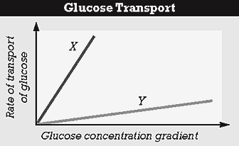
Chapter 5
Standardized Test Prep
Multiple Choice, continued
The graph below shows
the rate of glucose transport across a cell membrane
versus the concentration gradient. Use the graph that
follows to answer the question.
5. Which line represents the diffusion of glucose through the lipid bilayer?
A. line X
B. line Y
C. both lines X and Y
D. neither line X nor Y

Slide 113
Chapter 5
Standardized Test Prep
Multiple Choice, continued
The graph below shows
the rate of glucose transport across a cell membrane
versus the concentration gradient. Use the graph that
follows to answer the question.
5. Which line represents the diffusion of glucose through the lipid bilayer?
A. line X
B. line Y
C. both lines X and Y
D. neither line X nor Y

Slide 114
Chapter 5
Standardized Test Prep
Multiple Choice, continued
6. passive transport : osmosis :: active transport :
F. cytolysis
G. diffusion
H. ion channel
J. endocytosis

Slide 115
Chapter 5
Standardized Test Prep
Multiple Choice, continued
6. passive transport : osmosis :: active transport :
F. cytolysis
G. diffusion
H. ion channel
J. endocytosis

Slide 116
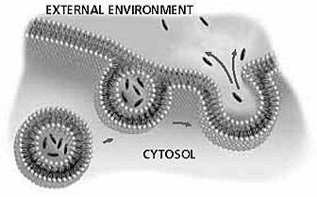
Chapter 5
Standardized Test Prep
Multiple Choice, continued
The diagram below
shows one form of cellular transport. Use the diagram
to answer the question that follows.
7. What form of cellular transport is being illustrated in the diagram?
A. osmosis
B. exocytosis
C. facilitated diffusion
D. a cell membrane pump

Slide 117
Chapter 5
Standardized Test Prep
Multiple Choice, continued
The diagram below
shows one form of cellular transport. Use the diagram
to answer the question that follows.
7. What form of cellular transport is being illustrated in the diagram?
A. osmosis
B. exocytosis
C. facilitated diffusion
D. a cell membrane pump

Slide 118
Chapter 5
Standardized Test Prep
Short Response
When a cell takes in substances through endocytosis, the outside of the cell membrane becomes the inside of the vesicle.
What might this suggest about the structure of the cell membrane?

Slide 119
Chapter 5
Standardized Test Prep
Short Response, continued
When a cell takes in substances through endocytosis, the outside of the cell membrane becomes the inside of the vesicle.
What might this suggest about the structure of the cell membrane?
Answer:
This suggests that the cell membrane’s inner and outer layers have essentially the same structure and are, therefore, interchangeable.

Slide 120
Chapter 5
Standardized Test Prep
Extended Response
Some cells have carrier proteins that transport sugar molecules and hydrogen ions into the cytosol at the same time. These proteins move sugar up their gradient as hydrogen ions move down their gradient.
Part A How would the transport of sugar into these cells affect the pH of the cells’ external environment?
Part B What would happen to the transport of sugar if hydrogen ions were removed from the external environment?

Slide 121
Chapter 5
Standardized Test Prep
Extended Response, continued
Answer:
Part A Because H⁺ ions move into the cells with the sugar molecules, the transport of sugar into the cells would lower the concentration of H⁺ ions in the external environment, raising the pH.
Part B Removing H⁺ ions from the external environment would stop the entry of sugar into the cells by this mechanism.

Slide 122
Section 2 Introduction to Cells
Chapter 4
Cell Diversity

Slide 123
Section 2 Introduction to Cells
Chapter 4
Cell Diversity

Slide 124
Section 2 Introduction to Cells
Chapter 4
Basic Parts of a Cell

Slide 125
Section 2 Introduction to Cells
Chapter 4
Two Basic Types of Cells

Slide 126
Section 2 Introduction to Cells
Chapter 4
Cellular Organization

Slide 127
Section 3 Cell Organelles and Features
Chapter 4
Plasma Membrane

Slide 128
Section 3 Cell Organelles and Features
Chapter 4
Mitochondria

Slide 129
Section 4 Unique Features of Plant Cells
Chapter 4
Plant Cells

