Slide 2
Concept 39.5: Plants respond to attacks by herbivores and pathogens
Plants use defense systems to deter herbivory, prevent infection, and combat pathogens
© 2011 Pearson Education, Inc.

Slide 3
Defenses Against Herbivores
Herbivore, animals eating plants, is a stress that plants face in any ecosystem
Plants counter excessive herbivore with physical defenses, such as thorns and trichomes, and chemical defenses, such as distasteful or toxic compounds
Some plants even “recruit” predatory animals that help defend against specific herbivores
© 2011 Pearson Education, Inc.

Slide 4
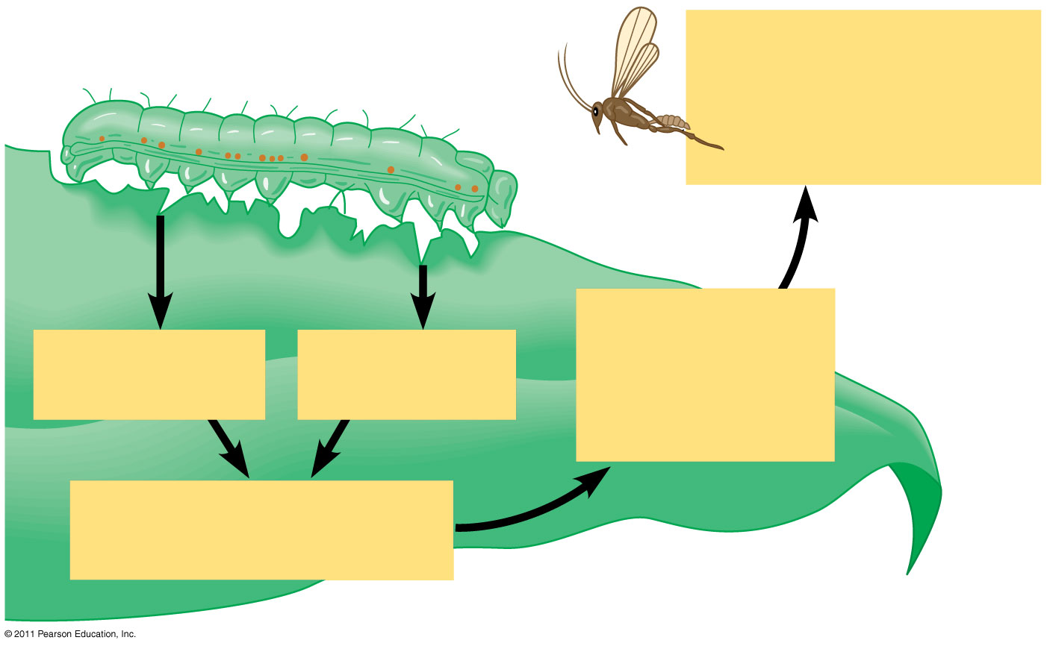
Figure 39.28
4
Recruitment of parasitoid wasps that lay their eggs within caterpillars
3
Synthesis and release of volatile attractants
1
Wounding
1
Chemical in saliva
2
Signal transduction pathway
Notes:
Figure 39.28 A maize leaf “recruiting” a parasitoid wasp as a defensive response to an armyworm caterpillar, an herbivore.

Slide 5
Plants damaged by insects can release volatile chemicals to warn other plants of the same species
Arabidopsis can be genetically engineered to produce volatile components that attract predatory mites
© 2011 Pearson Education, Inc.

Slide 6
Defenses Against Pathogens
A plant’s first line of defense against infection is the barrier presented by the epidermis and periderm
If a pathogen penetrates the dermal tissue, the second line of defense is a chemical attack that kills the pathogen and prevents its spread
This second defense system is enhanced by the inherited ability to recognize certain pathogens
© 2011 Pearson Education, Inc.

Slide 7
Host-Pathogen Coevolution
A virulent pathogen is one that a plant has little specific defense against
An avirulent pathogen is one that may harm but does not kill the host plant
© 2011 Pearson Education, Inc.

Slide 8
Gene-for-gene recognition involves recognition of elicitor molecules by the protein products of specific plant disease resistance (R) genes
An R protein recognizes a corresponding molecule made by the pathogen’s Avr gene
R proteins activate plant defenses by triggering signal transduction pathways
These defenses include the hypersensitive response and systemic acquired resistance
© 2011 Pearson Education, Inc.

Slide 9
The Hypersensitive Response
The hypersensitive response
Causes cell and tissue death near the infection site
Induces production of phytoalexins and PR proteins, which attack the pathogen
Stimulates changes in the cell wall that confine the pathogen
© 2011 Pearson Education, Inc.

Slide 10
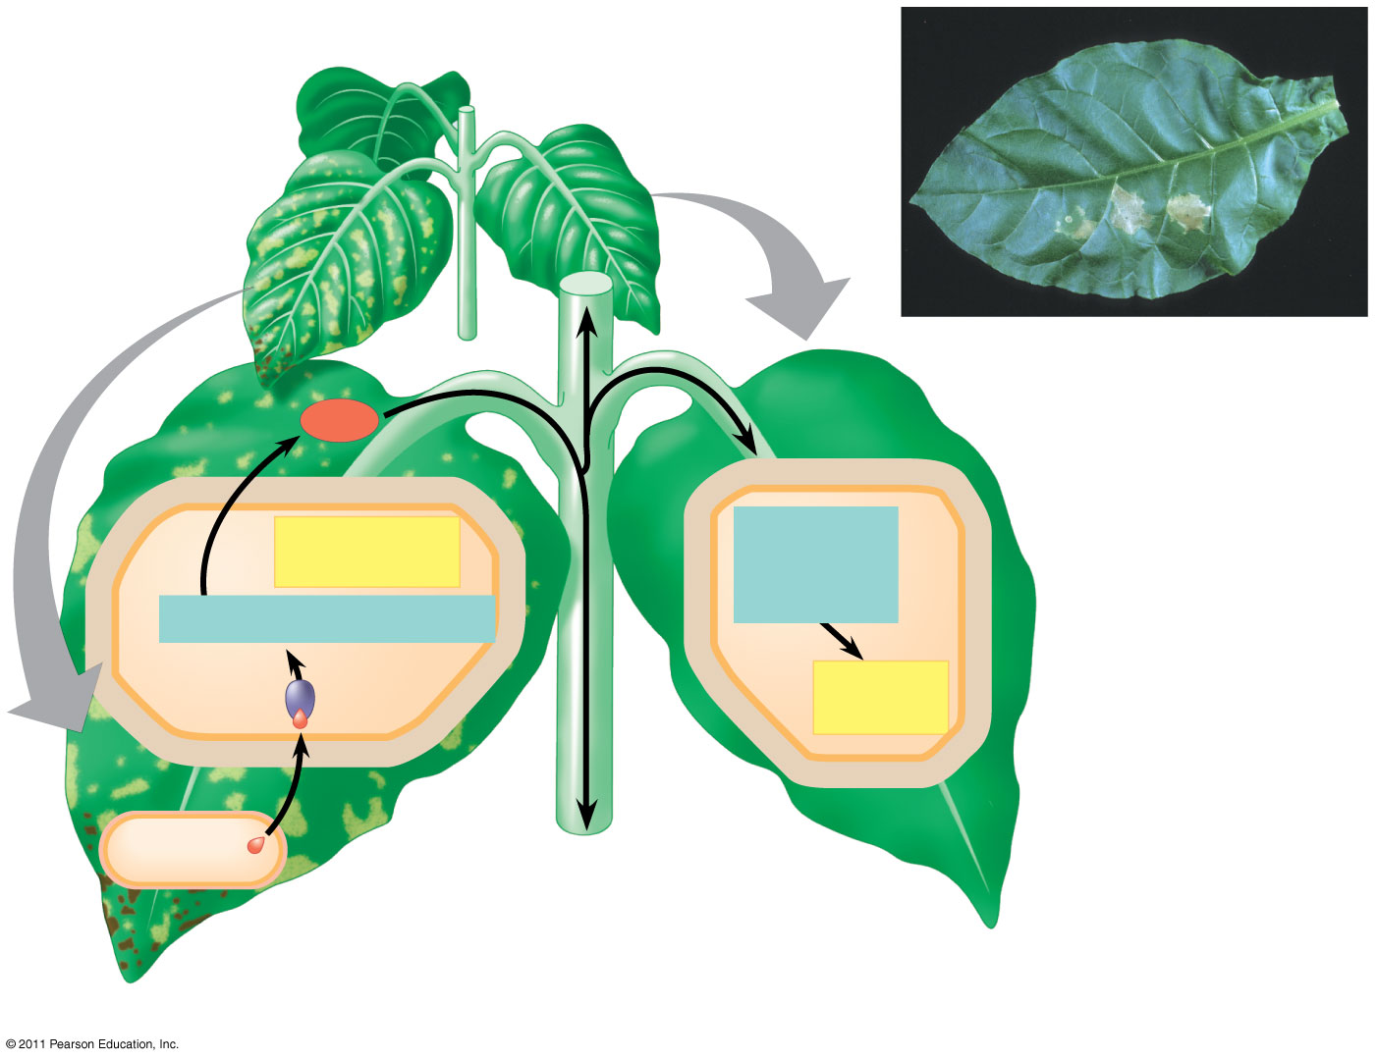
Figure 39.29
Infected tobacco leaf with lesions
4
Signal
5
Hypersensitive response
Signal transduction pathway
6
3
2
Signal transduction pathway
7
Acquired resistance
1
R protein
Avirulent pathogen
Avr effector protein
R-Avr recognition and hypersensitive response
Systemic acquired resistance
Notes:
Figure 39.29 Defense responses against an avirulent pathogen.

Slide 11
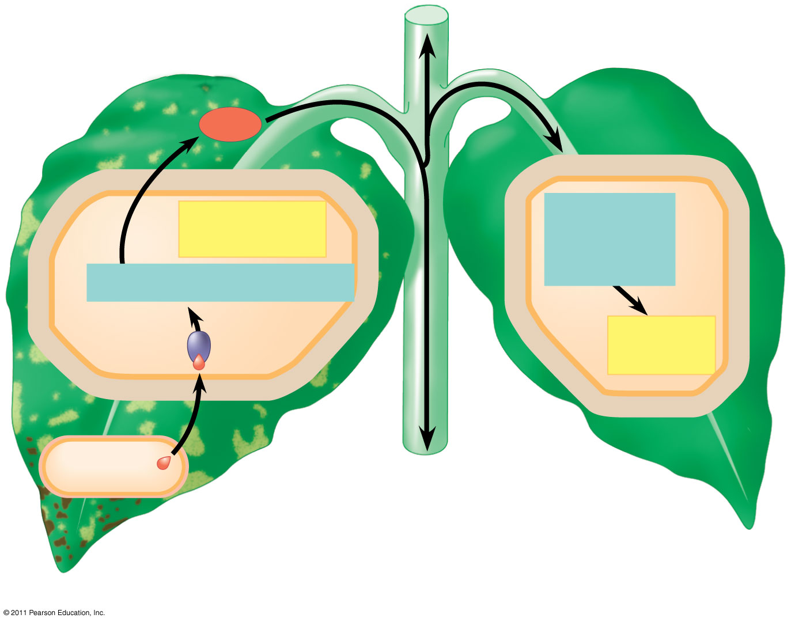
Figure 39.29a
4
Signal
5
Hypersensitive response
Signal transduction pathway
6
3
2
Signal transduction pathway
7
Acquired resistance
1
R protein
Avirulent pathogen
Avr effector protein
R-Avr recognition and hypersensitive response
Systemic acquired resistance
Notes:
Figure 39.29 Defense responses against an avirulent pathogen.

Slide 12
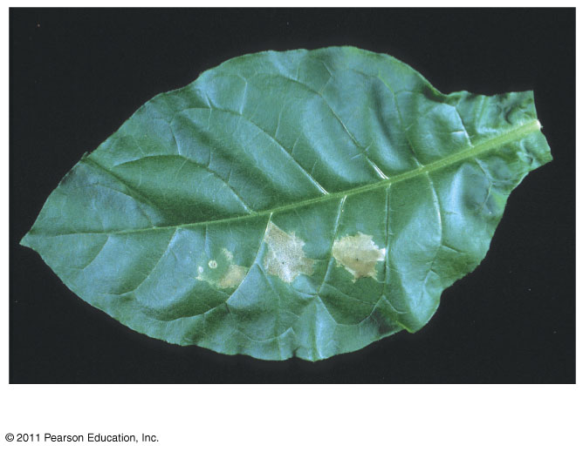
Figure 39.29b
Infected tobacco leaf with lesions
Notes:
Figure 39.29 Defense responses against an avirulent pathogen.

Slide 13
Systemic Acquired Resistance
Systemic acquired resistance causes systemic expression of defense genes and is a long-lasting response
Salicylic acid is synthesized around the infection site and is likely the signal that triggers systemic acquired resistance
© 2011 Pearson Education, Inc.

Slide 14
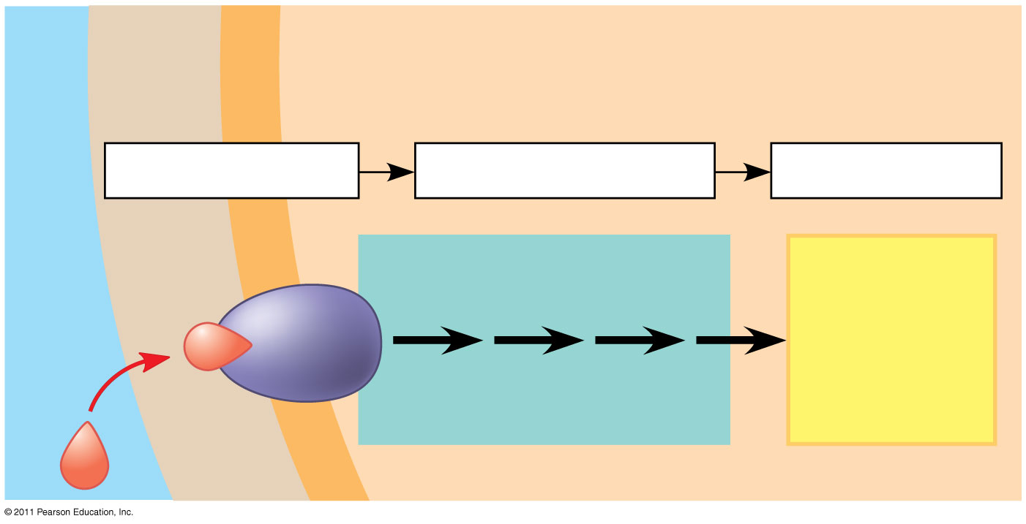
Figure 39.UN02
CELL WALL
CYTOPLASM
Plasma membrane
1
Reception
2
Transduction
3
Response
Hormone or environmental stimulus
Relay proteins and
Activation of cellular responses
second messengers
Receptor
Notes:
Figure 39.UN02 Summary figure, Concept 39.1

Slide 15
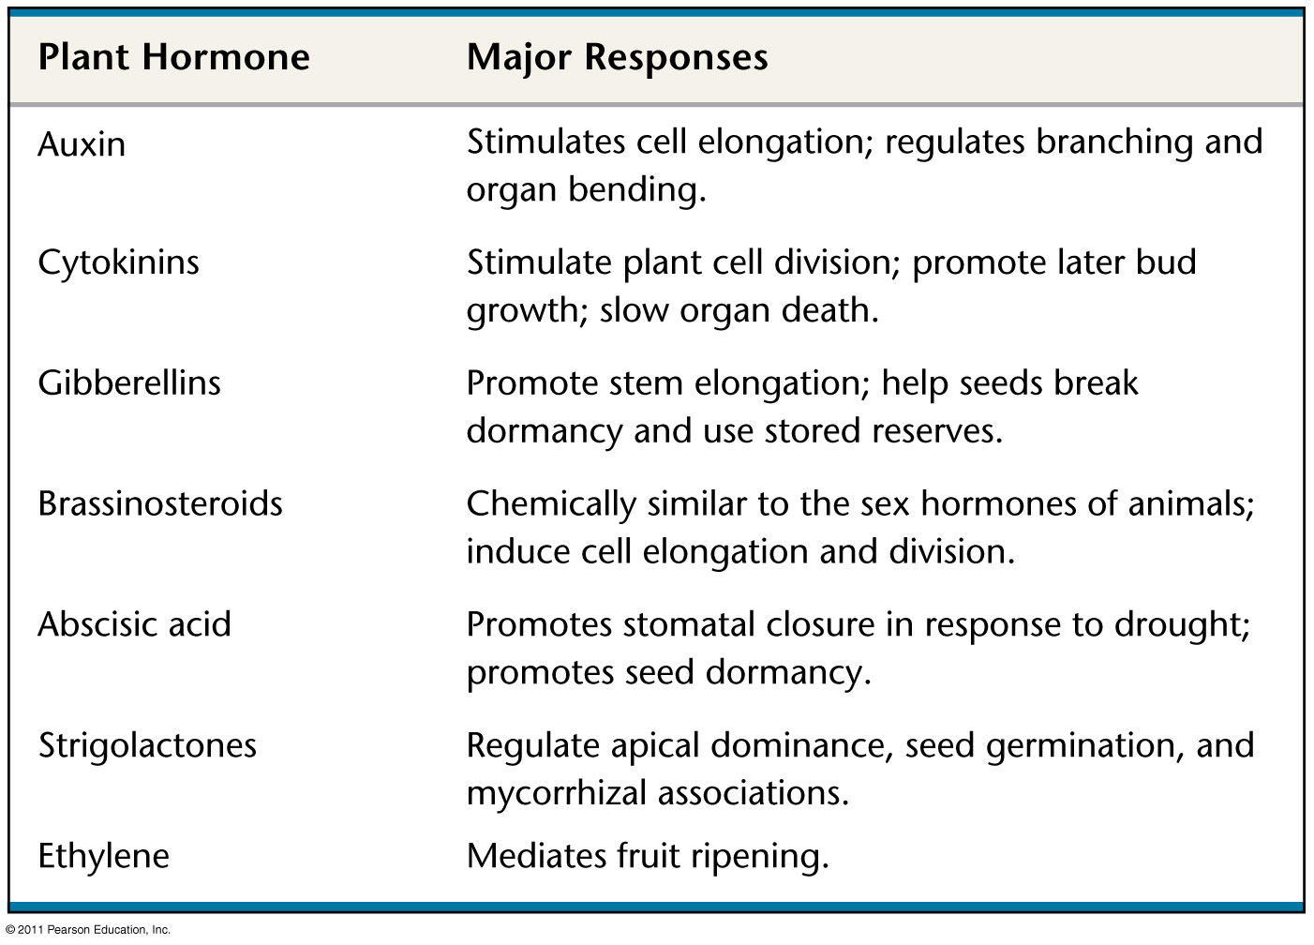
Figure 39.UN03
Notes:
Figure 39.UN03 Summary figure, Concept 39.2

Slide 16
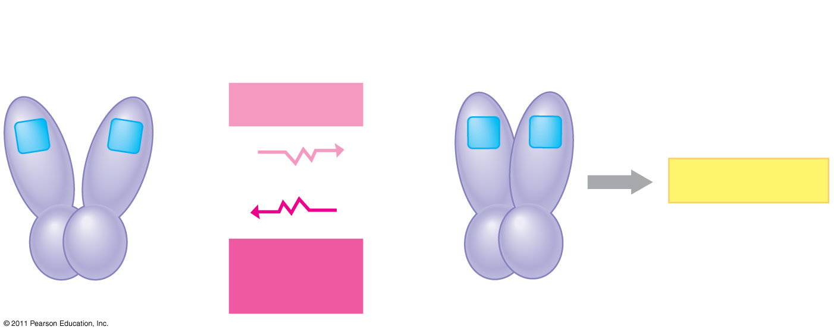
Figure 39.UN04
Photoreversible states of phytochrome:
P_{r}
P_{fr}
Red light
Responses
Far-red light
Notes:
Figure 39.UN04 Summary figure, Concept 39.3

Slide 17
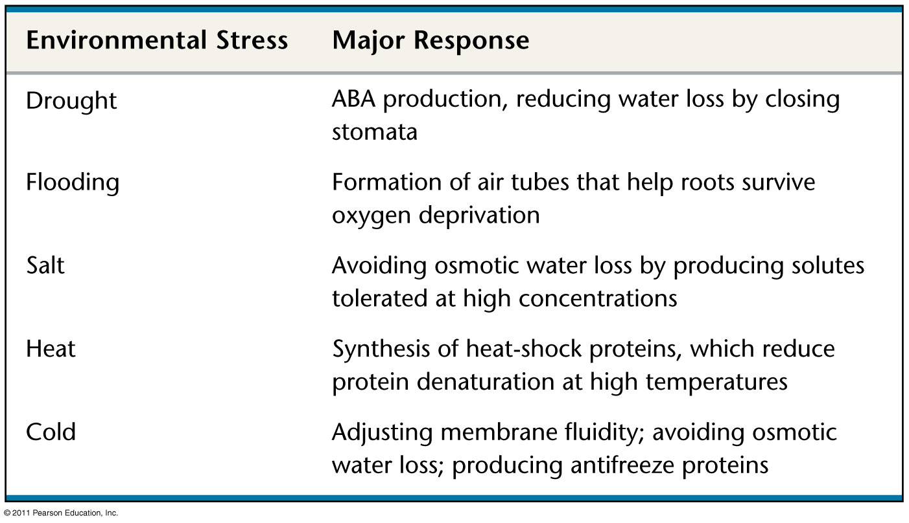
Figure 39.UN05
Notes:
Figure 39.UN05 Summary figure, Concept 39.4

Slide 18
Figure 39.UN06
Ethylene synthesis inhibitor
Ethylene added
Control
Wild-type
Ethylene insensitive (ein)
Ethylene overproducing (eto)
Constitutive triple response (ctr)
Notes:
Figure 39.UN06 Test Your Understanding, question 9

Slide 19
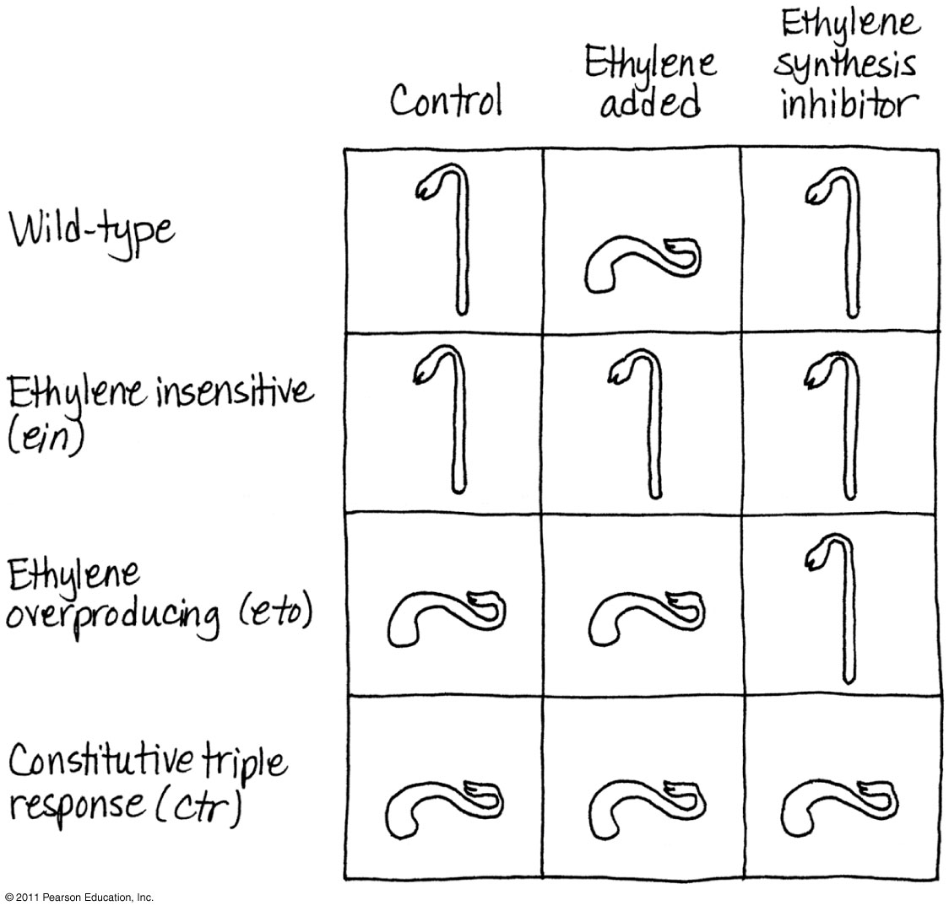
Figure 39.UN07
Notes:
Figure 39.UN07 Appendix A: answer for Test Your Understanding, question 9

