Slide 1
Concept 39.2: Plant hormones help coordinate growth, development, and responses to stimuli
Plant hormones are chemical signals that modify or control one or more specific physiological processes within a plant
© 2011 Pearson Education, Inc.

Slide 2
The Discovery of Plant Hormones
Any response resulting in curvature of organs toward or away from a stimulus is called a tropism
In the late 1800s, Charles Darwin and his son Francis conducted experiments on phototropism, a plant’s response to light
They observed that a grass seedling could bend toward light only if the tip of the coleoptile was present
© 2011 Pearson Education, Inc.

Slide 3
They postulated that a signal was transmitted from the tip to the elongating region
Video: Phototropism
© 2011 Pearson Education, Inc.

Slide 4
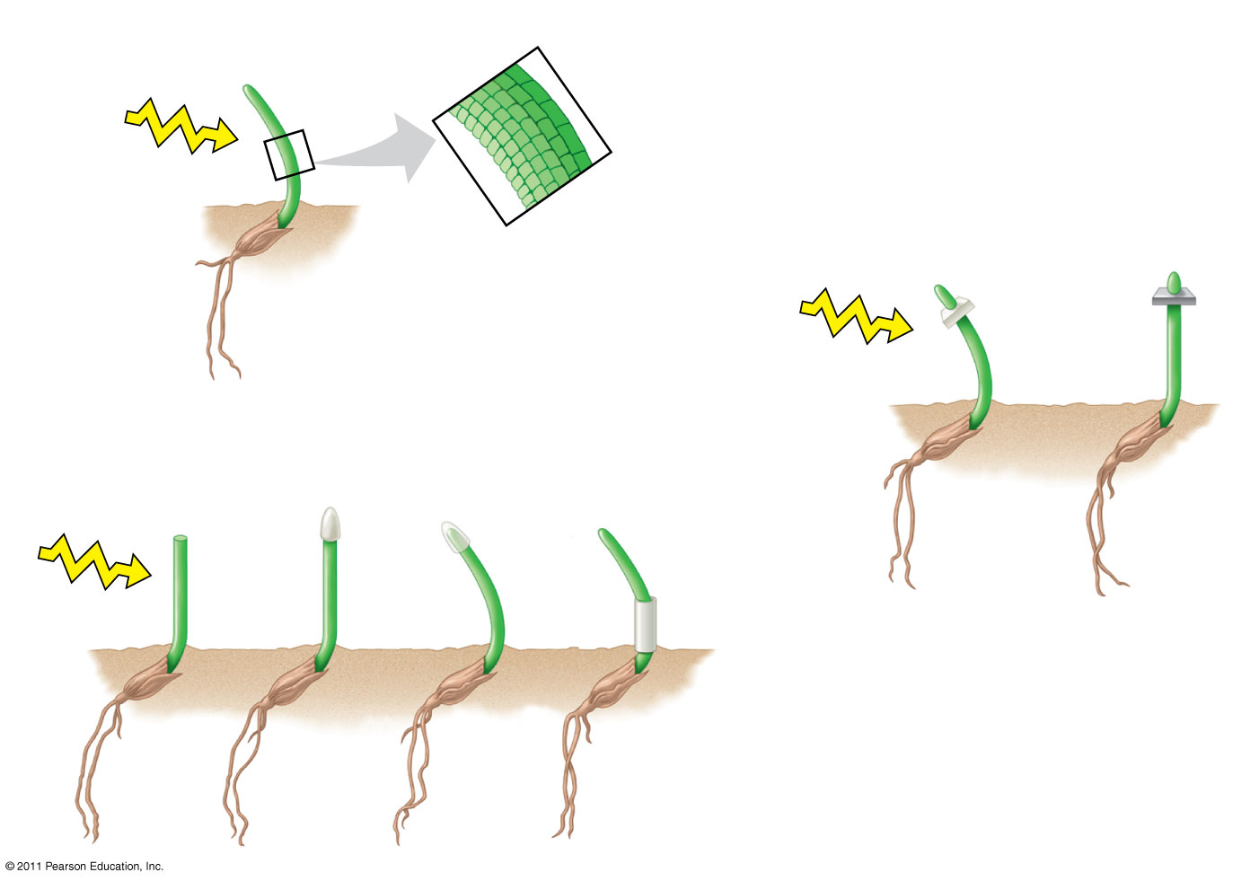
Figure 39.5
RESULTS
Shaded side
Control
Light
Illuminated side
Boysen-Jensen
Light
Darwin and Darwin
Light
Gelatin (permeable)
Mica (impermeable)
Tip removed
Opaque cap
Trans- parent cap
Opaque shield over curvature
Notes:
Figure 39.5 Inquiry: What part of a grass coleoptile senses light, and how is the signal transmitted?

Slide 5
In 1913, Peter Boysen-Jensen demonstrated that the signal was a mobile chemical substance
© 2011 Pearson Education, Inc.

Slide 6
In 1926, Frits Went extracted the chemical messenger for phototropism, auxin, by modifying earlier experiments
© 2011 Pearson Education, Inc.

Slide 7
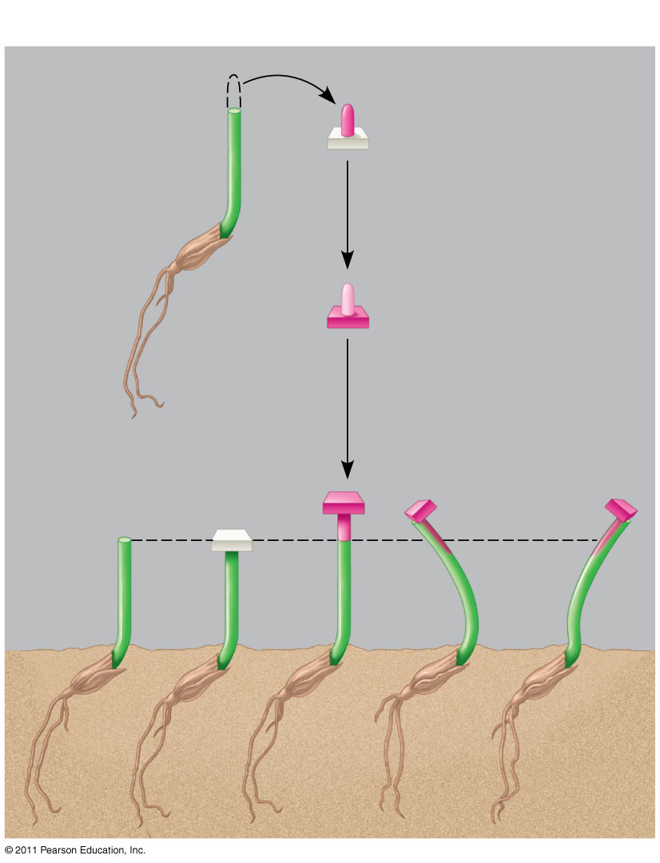
Figure 39.6
RESULTS
Excised tip on agar cube
Growth-promoting chemical diffuses into agar cube
Control (agar cube lacking chemical)
Offset cubes
Control
Notes:
Figure 39.6 Inquiry: Does asymmetrical distribution of a growth-promoting chemical cause a coleoptile to grow toward the light?

Slide 8
A Survey of Plant Hormones
Plant hormones are produced in very low concentration, but a minute amount can greatly affect growth and development of a plant organ
In general, hormones control plant growth and development by affecting the division, elongation, and differentiation of cells
© 2011 Pearson Education, Inc.

Slide 9
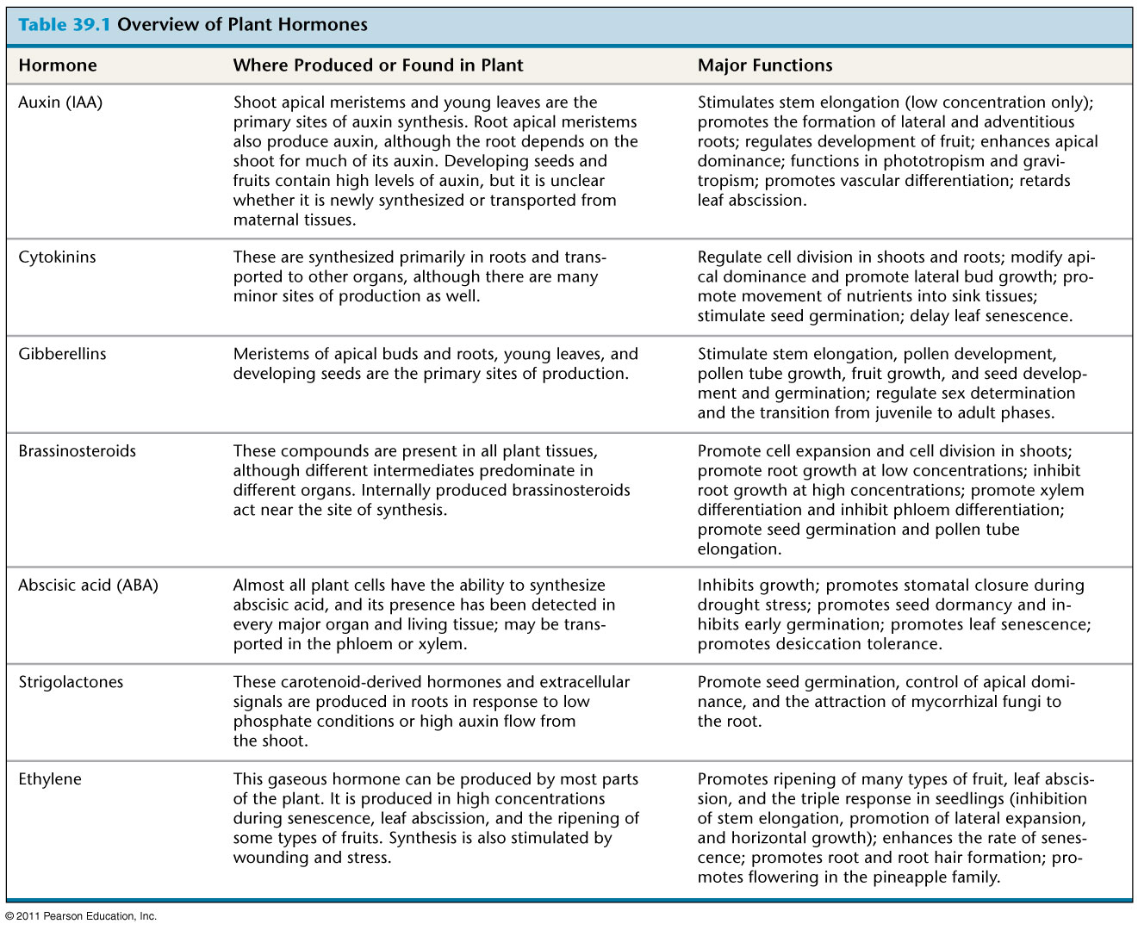
Table 39.1
Notes:
Table 39.1 Overview of Plant Hormones

Slide 10
Auxin
The term auxin refers to any chemical that promotes elongation of coleoptiles
Indoleacetic acid (IAA) is a common auxin in plants; in this lecture the term auxin refers specifically to IAA
Auxin is produced in shoot tips and is transported down the stem
Auxin transporter proteins move the hormone from the basal end of one cell into the apical end of the neighboring cell
© 2011 Pearson Education, Inc.

Slide 11
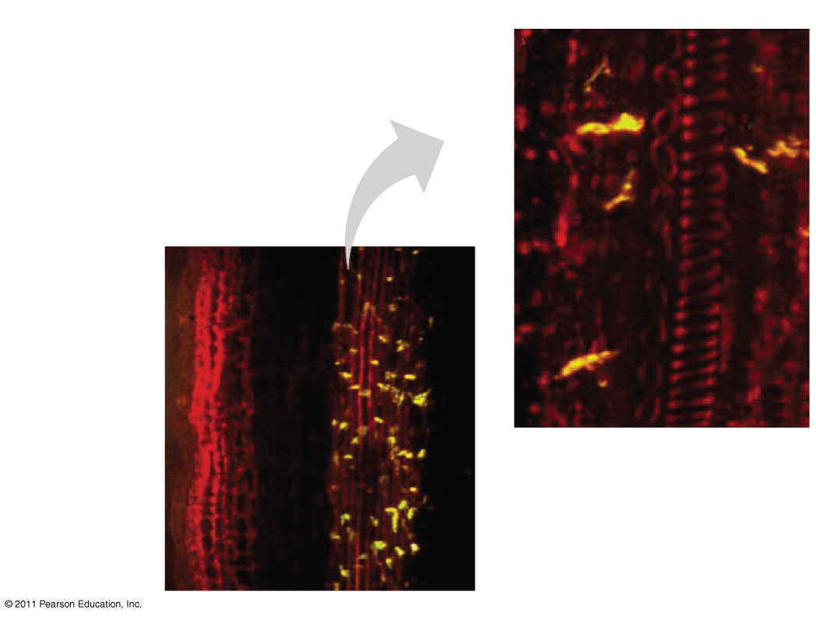
Figure 39.7
RESULTS
Cell 1
100 μm
Cell 2
Epidermis
Cortex
Phloem
Xylem
25 μm
Basal end of cell
Pith
Notes:
Figure 39.7 Inquiry: What causes polar movement of auxin from shoot tip to base?

Slide 12
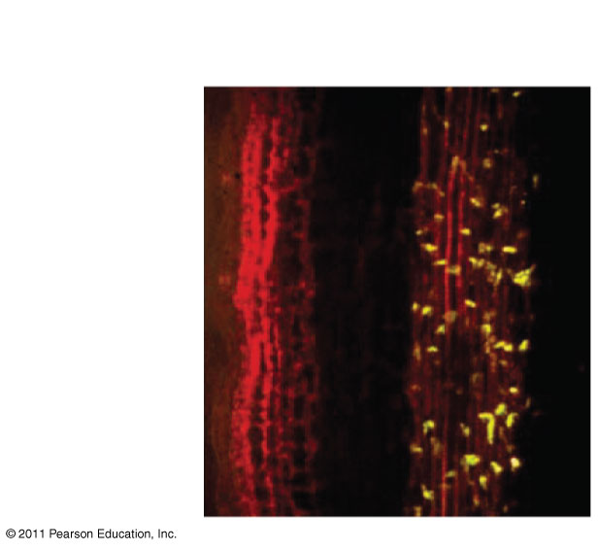
Figure 39.7a
100 μm
Epidermis
Cortex
Phloem
Xylem
Pith
Notes:
Figure 39.7 Inquiry: What causes polar movement of auxin from shoot tip to base?

Slide 13
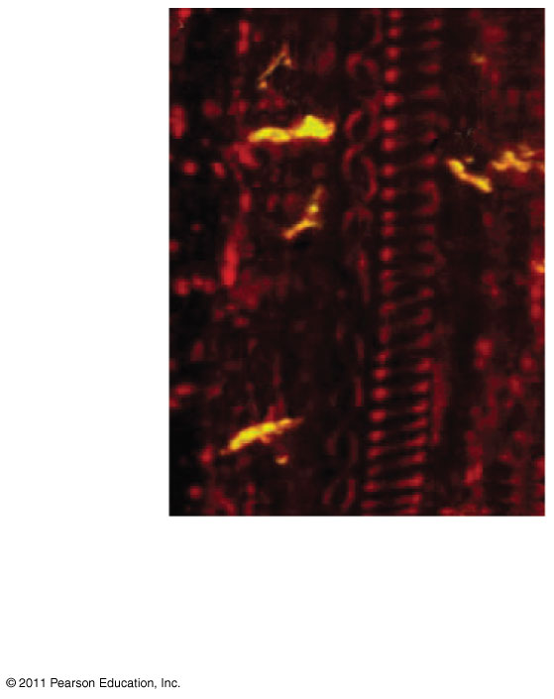
Figure 39.7b
Cell 1
Cell 2
25 μm
Basal end of cell
Notes:
Figure 39.7 Inquiry: What causes polar movement of auxin from shoot tip to base?

Slide 14
The Role of Auxin in Cell Elongation
According to the acid growth hypothesis, auxin stimulates proton pumps in the plasma membrane
The proton pumps lower the pH in the cell wall, activating expansins, enzymes that loosen the wall’s fabric
With the cellulose loosened, the cell can elongate
© 2011 Pearson Education, Inc.

Slide 15
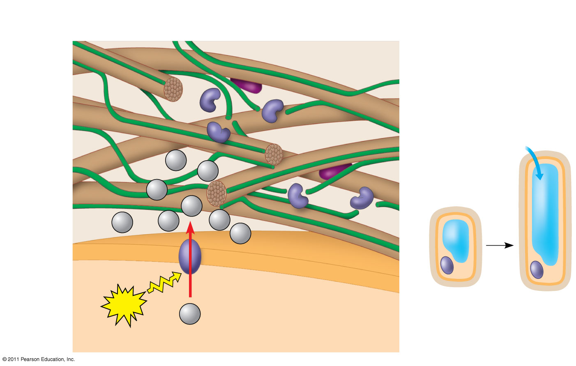
Figure 39.8
Cross-linking polysaccharides
Cell wall–loosening enzymes
Expansin
CELL WALL
Cellulose microfibril
H₂O
H⁺
Plasma membrane
H⁺
H⁺
Cell wall
H⁺
H⁺
H⁺
H⁺
H⁺
ATP
Plasma membrane
Nucleus
Cytoplasm
H⁺
Vacuole
CYTOPLASM
Notes:
Figure 39.8 Cell elongation in response to auxin: the acid growth hypothesis.

Slide 16
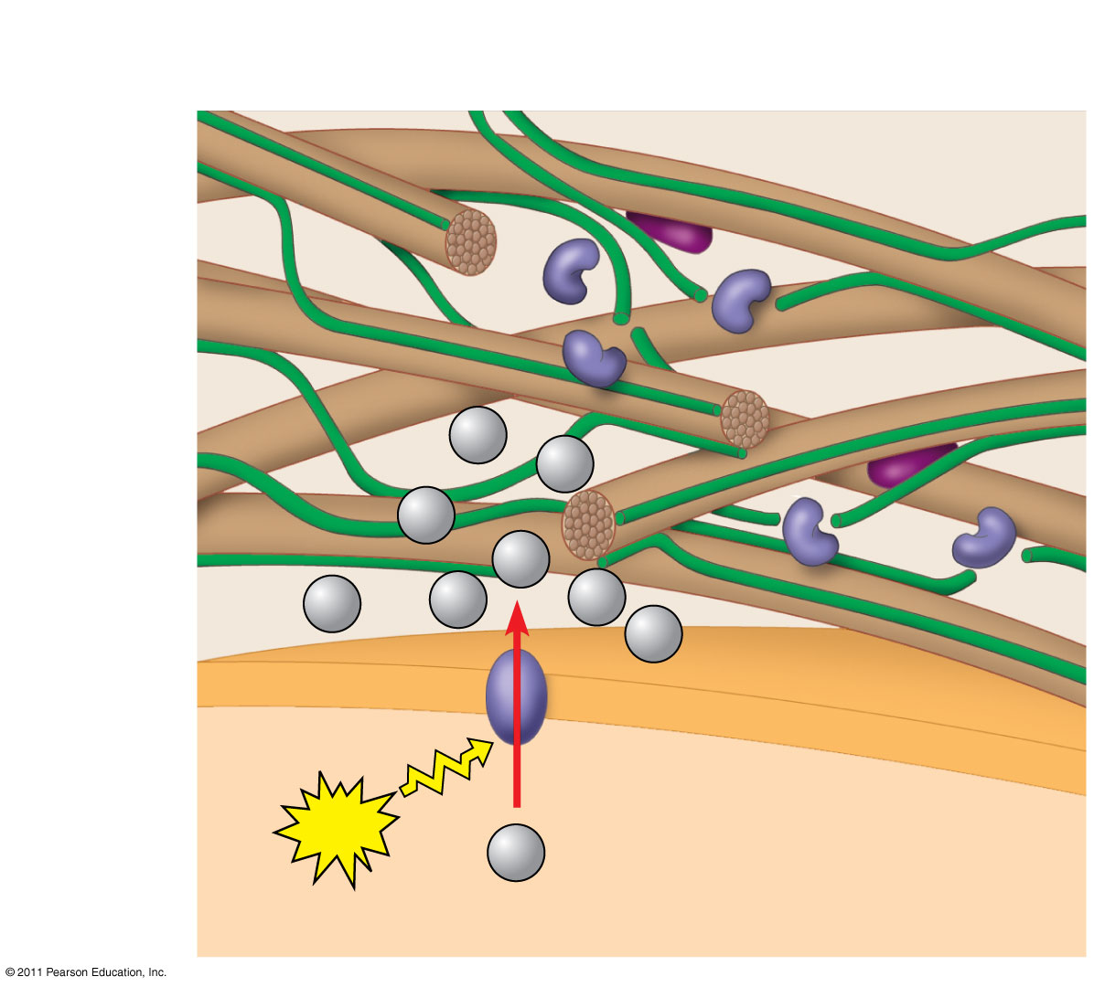
Figure 39.8a
Cross-linking polysaccharides
Cell wall–loosening enzymes
Expansin
CELL WALL
Cellulose microfibril
H⁺
H⁺
H⁺
H⁺
H⁺
H⁺
H⁺
H⁺
ATP
Plasma membrane
H⁺
CYTOPLASM
Notes:
Figure 39.8 Cell elongation in response to auxin: the acid growth hypothesis.

Slide 17
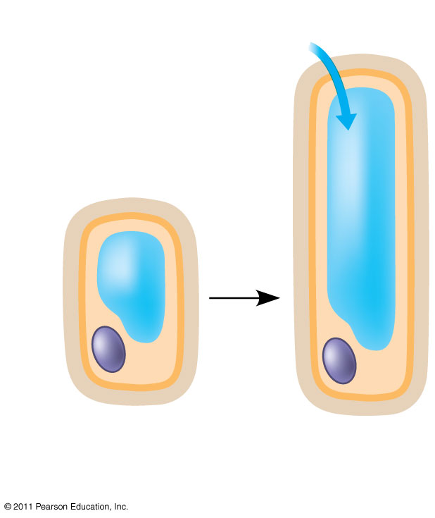
Figure 39.8b
H₂O
Plasma membrane
Cell wall
Nucleus
Cytoplasm
Vacuole
Notes:
Figure 39.8 Cell elongation in response to auxin: the acid growth hypothesis.

Slide 18
Auxin also alters gene expression and stimulates a sustained growth response
© 2011 Pearson Education, Inc.

Slide 19
Auxin’s Role in Plant Development
Polar transport of auxin plays a role in pattern formation of the developing plant
Reduced auxin flow from the shoot of a branch stimulates growth in lower branches
Auxin transport plays a role in phyllotaxy, the arrangement of leaves on the stem
Polar transport of auxin from leaf margins directs leaf venation pattern
The activity of the vascular cambium is under control of auxin transport
© 2011 Pearson Education, Inc.

Slide 20
Practical Uses for Auxins
The auxin indolbutyric acid (IBA) stimulates adventitious roots and is used in vegetative propagation of plants by cuttings
An overdose of synthetic auxins can kill plants
For example 2,4-D is used as an herbicide on eudicots
© 2011 Pearson Education, Inc.

Slide 21
Cytokinins
Cytokinins are so named because they stimulate cytokinesis (cell division)
© 2011 Pearson Education, Inc.

Slide 22
Control of Cell Division and Differentiation
Cytokinins are produced in actively growing tissues such as roots, embryos, and fruits
Cytokinins work together with auxin to control cell division and differentiation
© 2011 Pearson Education, Inc.

Slide 23
Control of Apical Dominance
Cytokinins, auxin, and strigolactone interact in the control of apical dominance, a terminal bud’s ability to suppress development of axillary buds
If the terminal bud is removed, plants become bushier
© 2011 Pearson Education, Inc.

Slide 24
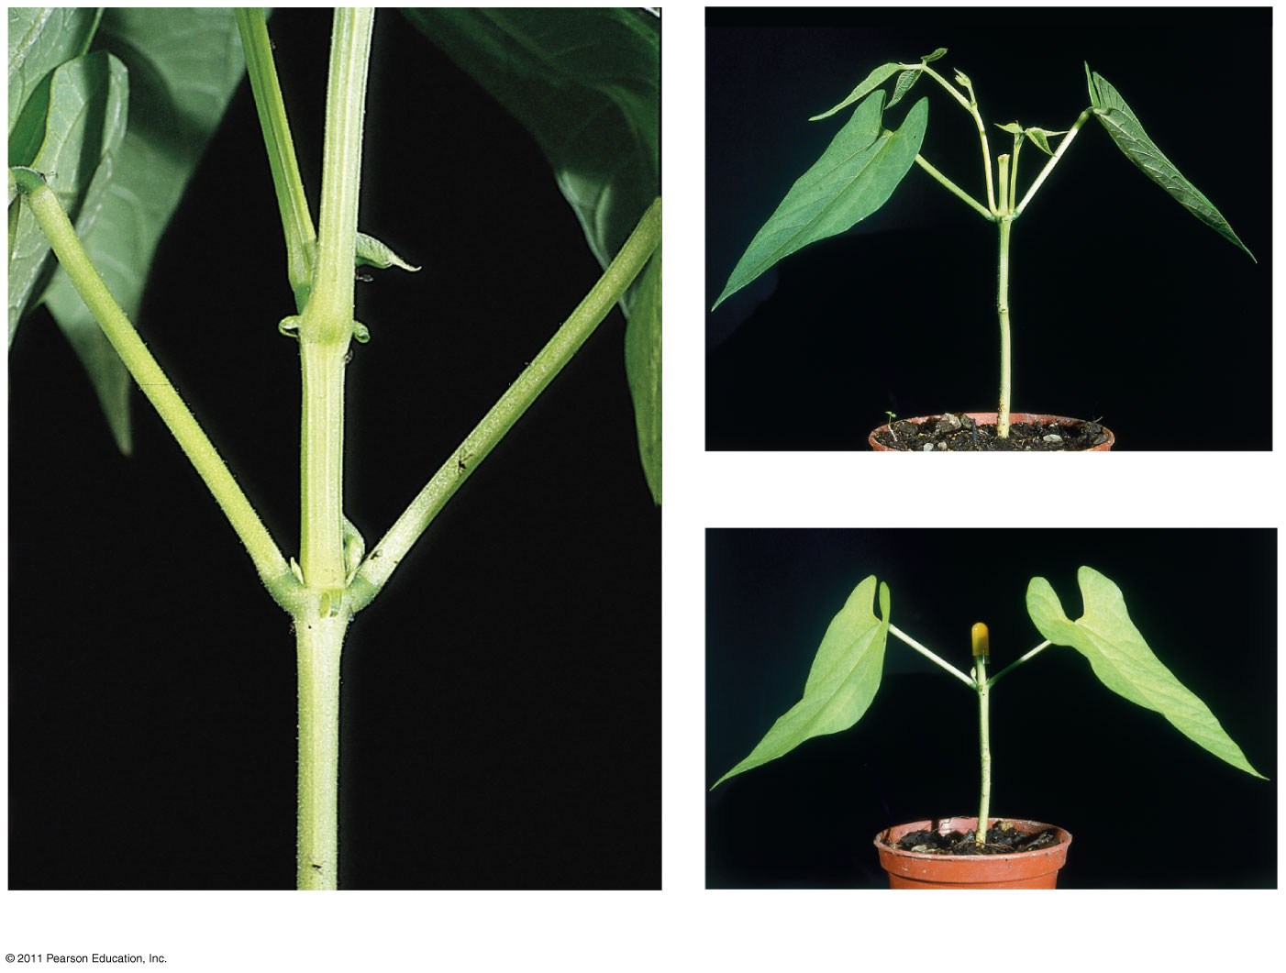
Figure 39.9
Lateral branches
“Stump” after removal of apical bud
(b) Apical bud removed
Axillary buds
(a) Apical bud intact (not shown in photo)
(c) Auxin added to decapitated stem
Notes:
Figure 39.9 Apical dominance.

Slide 25
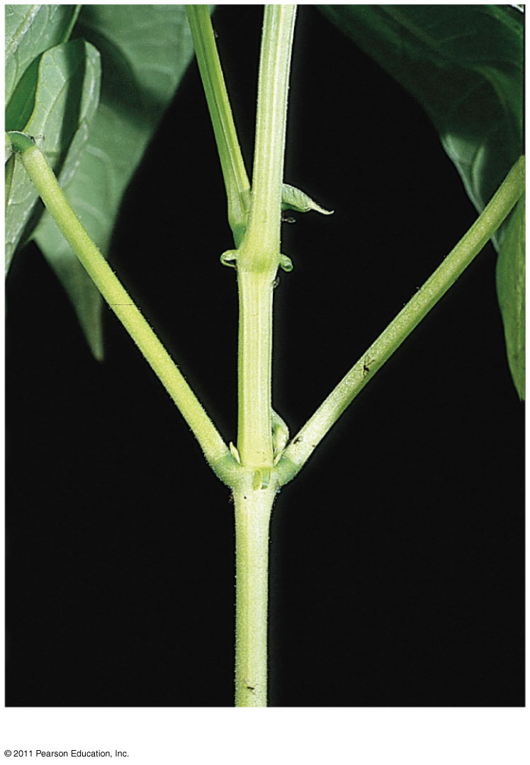
Figure 39.9a
Axillary buds
(a) Apical bud intact (not shown in photo)
Notes:
Figure 39.9 Apical dominance.

Slide 26
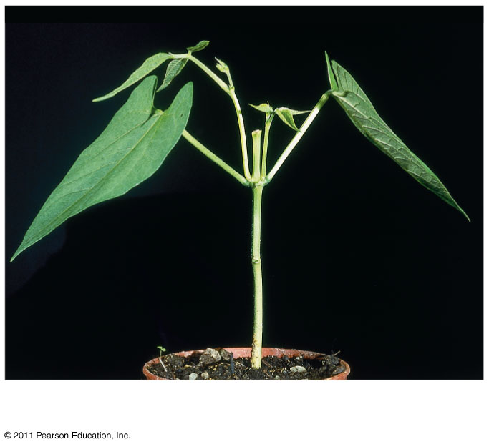
Figure 39.9b
Lateral branches
“Stump” after removal of apical bud
(b) Apical bud removed
Notes:
Figure 39.9 Apical dominance.

Slide 27
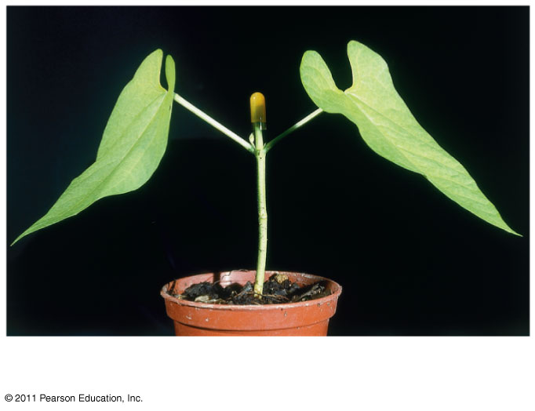
Figure 39.9c
(c) Auxin added to decapitated stem
Notes:
Figure 39.9 Apical dominance.

Slide 28
Anti-Aging Effects
Cytokinins slow the aging of some plant organs by inhibiting protein breakdown, stimulating RNA and protein synthesis, and mobilizing nutrients from surrounding tissues
© 2011 Pearson Education, Inc.

Slide 29
Gibberellins
Gibberellins have a variety of effects, such as stem elongation, fruit growth, and seed germination
© 2011 Pearson Education, Inc.

Slide 30
Stem Elongation
Gibberellins are produced in young roots and leaves
Gibberellins stimulate growth of leaves and stems
In stems, they stimulate cell elongation and cell division
© 2011 Pearson Education, Inc.

Slide 31
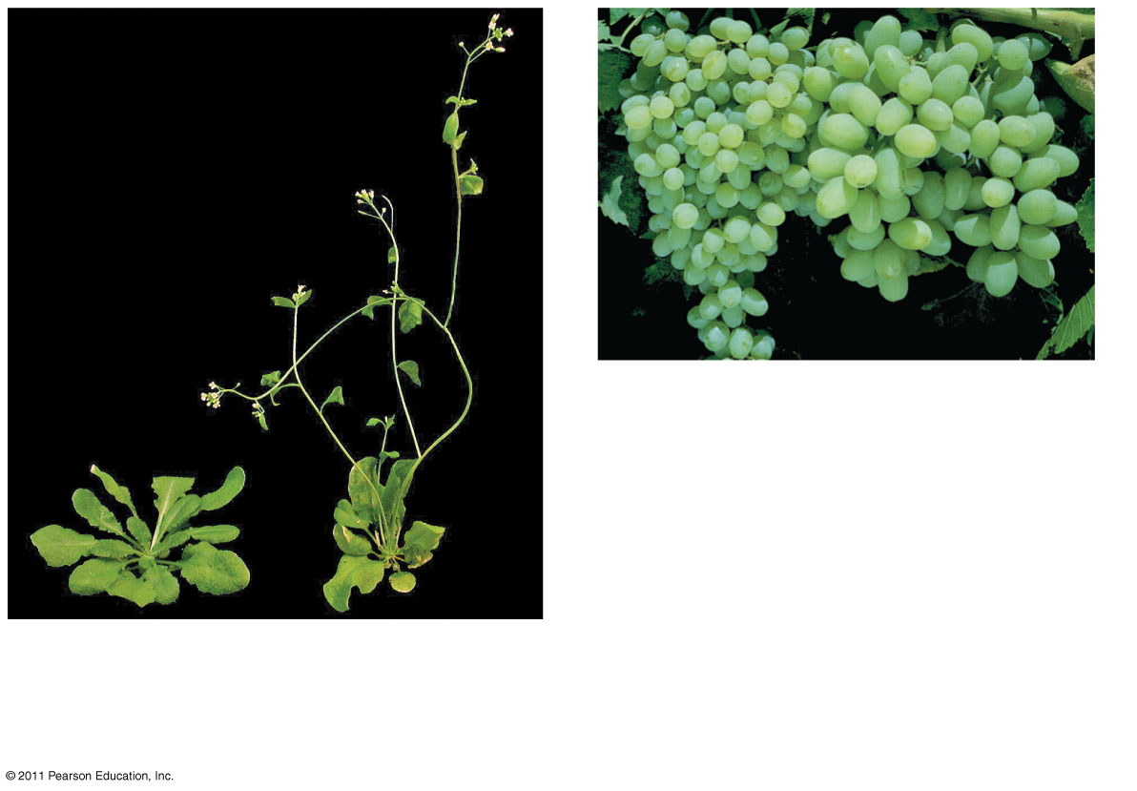
Figure 39.10
(b)
Grapes from control vine (left) and gibberellin-treated vine (right)
(a)
Rosette form (left) and gibberellin-induced bolting (right)
Notes:
Figure 39.10 Effects of gibberellins on stem elongation and fruit growth.

Slide 32
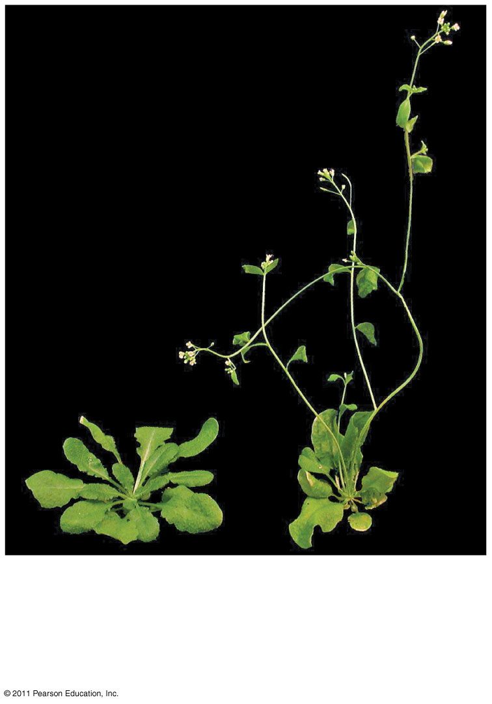
Figure 39.10a
(a)
Rosette form (left) and gibberellin-induced bolting (right)
Notes:
Figure 39.10 Effects of gibberellins on stem elongation and fruit growth.

Slide 33
Fruit Growth
In many plants, both auxin and gibberellins must be present for fruit to develop
Gibberellins are used in spraying of Thompson seedless grapes
© 2011 Pearson Education, Inc.

Slide 34
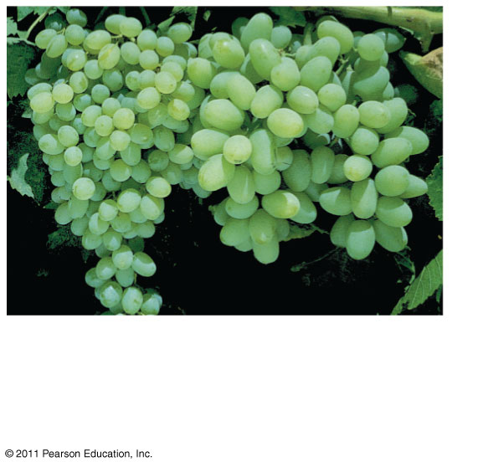
Figure 39.10b
(b)
Grapes from control vine (left) and gibberellin-treated vine (right)
Notes:
Figure 39.10 Effects of gibberellins on stem elongation and fruit growth.

Slide 35
Germination
After water is imbibed, release of gibberellins from the embryo signals seeds to germinate
© 2011 Pearson Education, Inc.

Slide 36
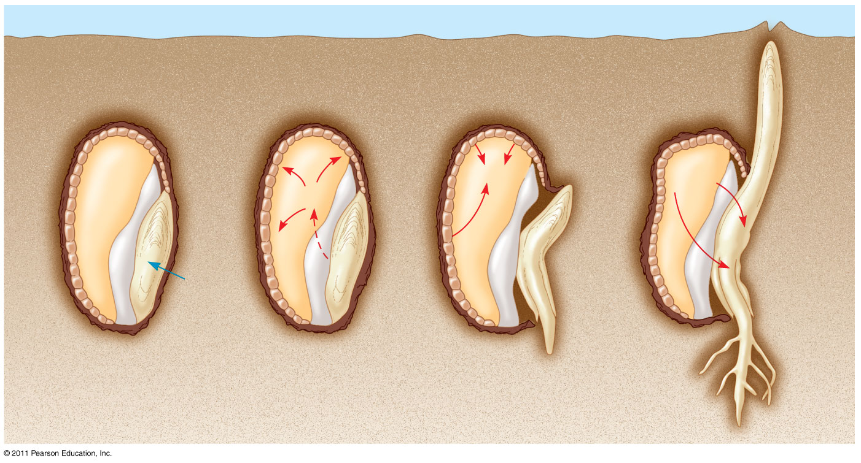
Figure 39.11
Aleurone
Endosperm
1
2
3
α-amylase
Sugar
GA
GA
Water
Scutellum (cotyledon)
Radicle
Notes:
Figure 39.11 Mobilization of nutrients by gibberellins during the germination of grain seeds such as barley.

Slide 37
Brassinosteroids
Brassinosteroids are chemically similar to the sex hormones of animals
They induce cell elongation and division in stem segments
They slow leaf abscission and promote xylem differentiation
© 2011 Pearson Education, Inc.

Slide 38
Abscisic Acid
Abscisic acid (ABA) slows growth
Two of the many effects of ABA
Seed dormancy
Drought tolerance
© 2011 Pearson Education, Inc.

Slide 39
Seed Dormancy
Seed dormancy ensures that the seed will germinate only in optimal conditions
In some seeds, dormancy is broken when ABA is removed by heavy rain, light, or prolonged cold
Precocious (early) germination can be caused by inactive or low levels of ABA
© 2011 Pearson Education, Inc.

Slide 40
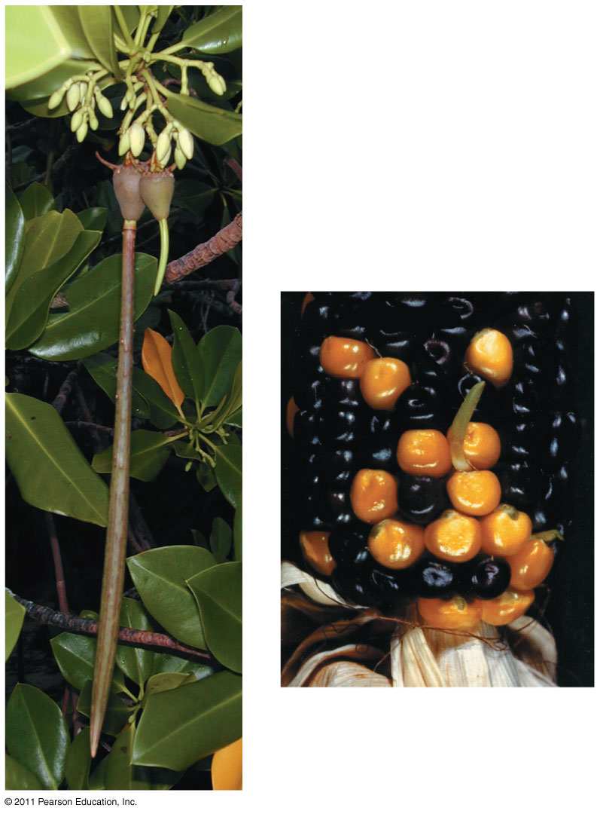
Figure 39.12
Red mangrove (Rhizophora mangle) seeds
Coleoptile
Maize mutant
Notes:
Figure 39.12 Precocious germination of wild-type mangrove and mutant maize seeds.

Slide 41
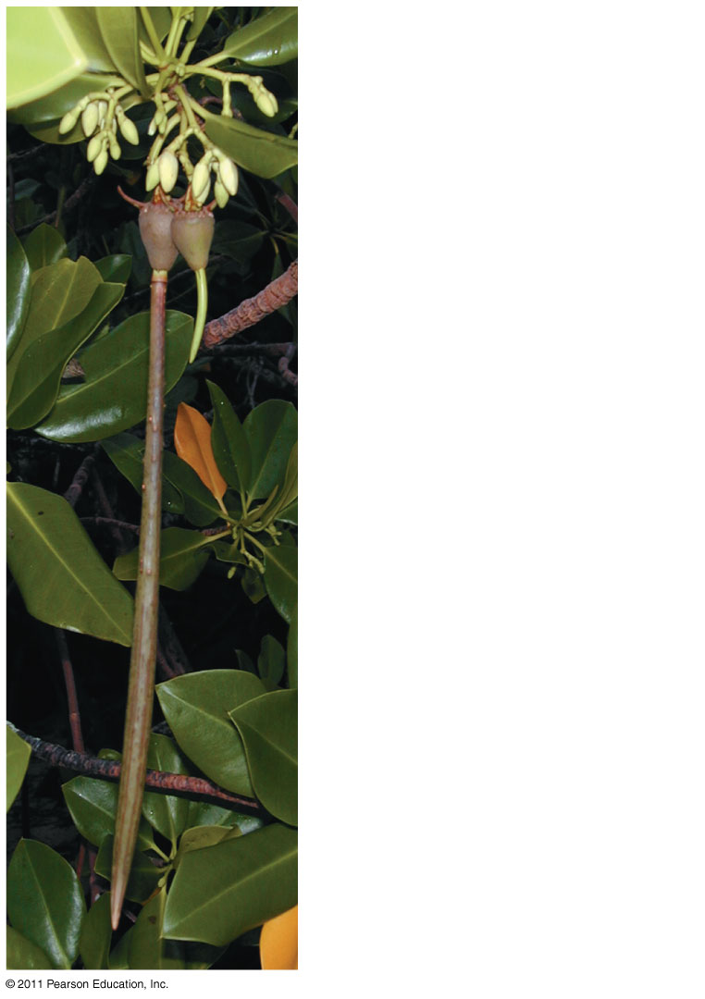
Figure 39.12a
Red mangrove (Rhizophora mangle) seeds
Notes:
Figure 39.12 Precocious germination of wild-type mangrove and mutant maize seeds.

Slide 42
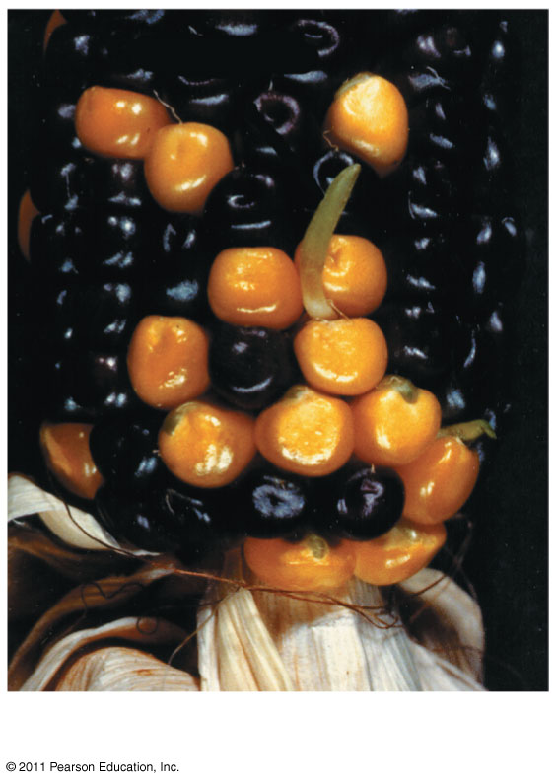
Figure 39.12b
Coleoptile
Maize mutant
Notes:
Figure 39.12 Precocious germination of wild-type mangrove and mutant maize seeds.

Slide 43
Drought Tolerance
ABA is the primary internal signal that enables plants to withstand drought
ABA accumulation causes stomata to close rapidly
© 2011 Pearson Education, Inc.

Slide 44
Strigolactones
The hormones called strigolactones
Stimulate seed germination
Help establish mycorrhizal associations
Help control apical dominance
Strigolactones are named for parasitic Striga plants
Striga seeds germinate when host plants exude strigolactones through their roots
© 2011 Pearson Education, Inc.

Slide 45
Ethylene
Plants produce ethylene in response to stresses such as drought, flooding, mechanical pressure, injury, and infection
The effects of ethylene include response to mechanical stress, senescence, leaf abscission, and fruit ripening
© 2011 Pearson Education, Inc.

Slide 46
The Triple Response to Mechanical Stress
Ethylene induces the triple response, which allows a growing shoot to avoid obstacles
The triple response consists of a slowing of stem elongation, a thickening of the stem, and horizontal growth
© 2011 Pearson Education, Inc.

Slide 47
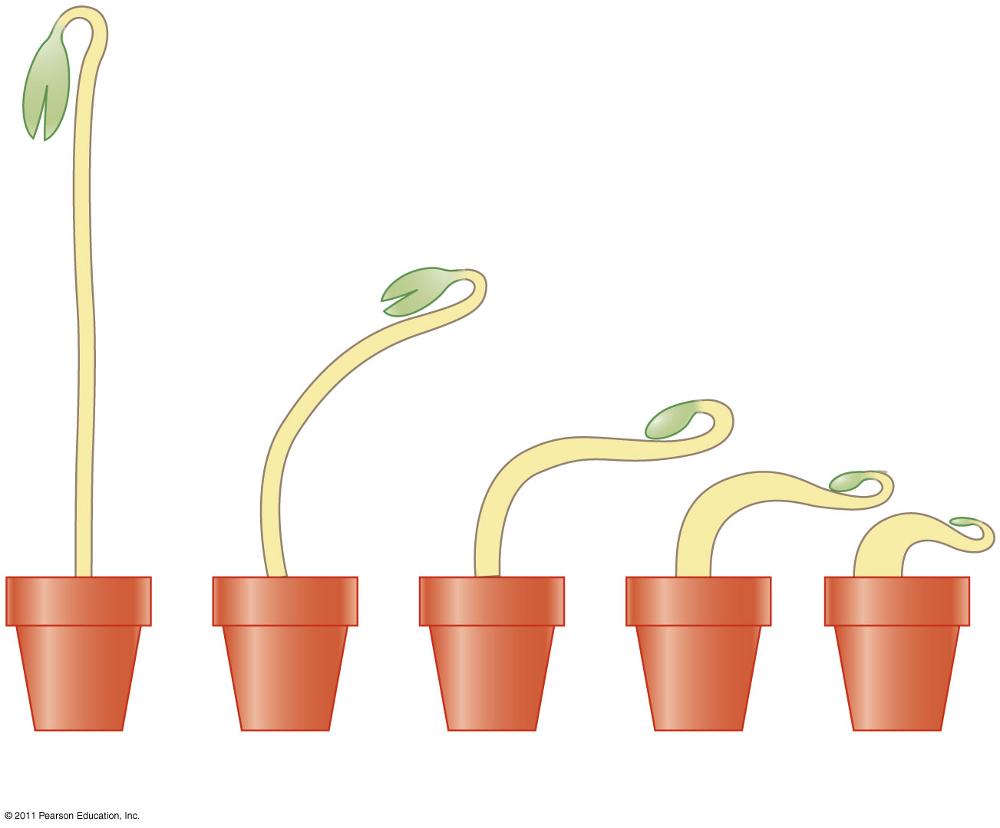
Figure 39.13
0.00
0.10
0.20
0.40
0.80
Ethylene concentration (parts per million)
Notes:
Figure 39.13 The ethylene-induced triple response.

Slide 48
Ethylene-insensitive mutants fail to undergo the triple response after exposure to ethylene
Other mutants undergo the triple response in air but do not respond to inhibitors of ethylene synthesis
© 2011 Pearson Education, Inc.

Slide 49
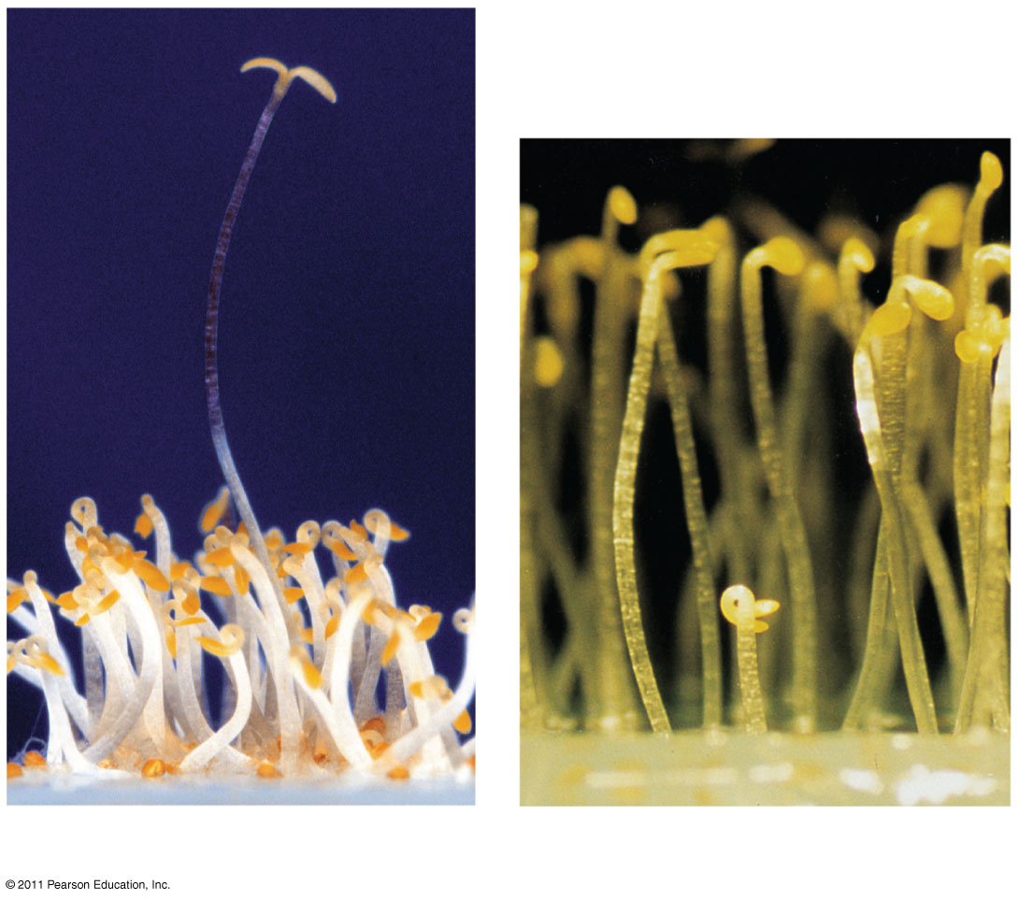
Figure 39.14
ein mutant
ctr mutant
(a) ein mutant
(b) ctr mutant
Notes:
Figure 39.14 Ethylene triple-response Arabidopsis mutants.

Slide 50
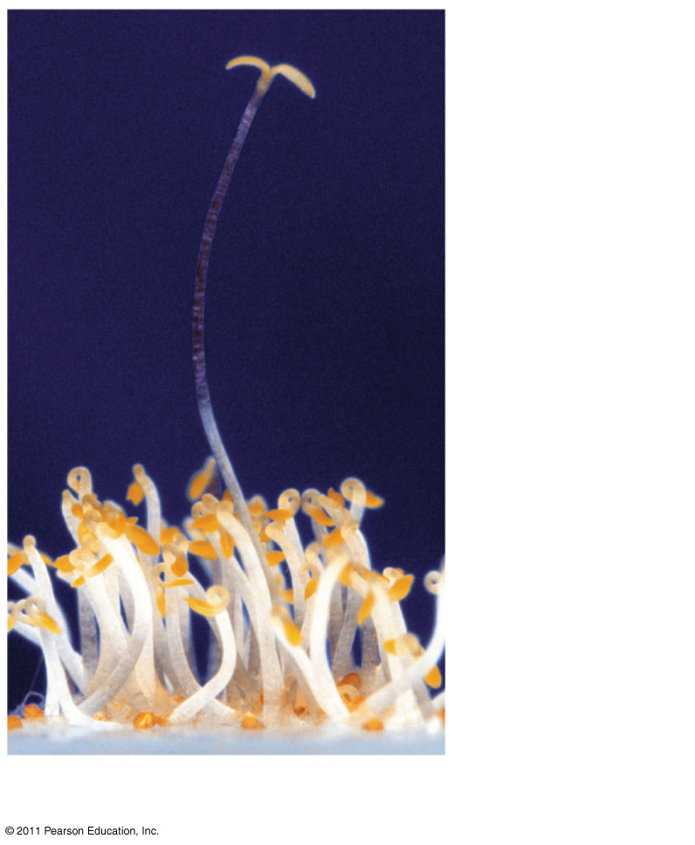
Figure 39.14a
ein mutant
(a) ein mutant
Notes:
Figure 39.14 Ethylene triple-response Arabidopsis mutants.

Slide 51
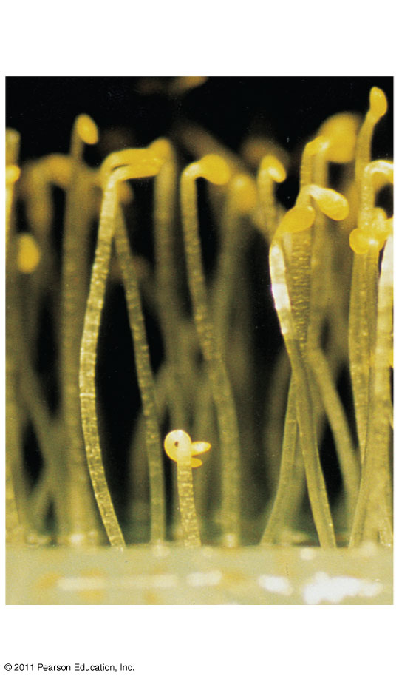
Figure 39.14b
ctr mutant
(b) ctr mutant
Notes:
Figure 39.14 Ethylene triple-response Arabidopsis mutants.

Slide 52
Senescence
Senescence is the programmed death of cells or organs
A burst of ethylene is associated with apoptosis, the programmed destruction of cells, organs, or whole plants
© 2011 Pearson Education, Inc.

Slide 53
Leaf Abscission
A change in the balance of auxin and ethylene controls leaf abscission, the process that occurs in autumn when a leaf falls
© 2011 Pearson Education, Inc.

Slide 54
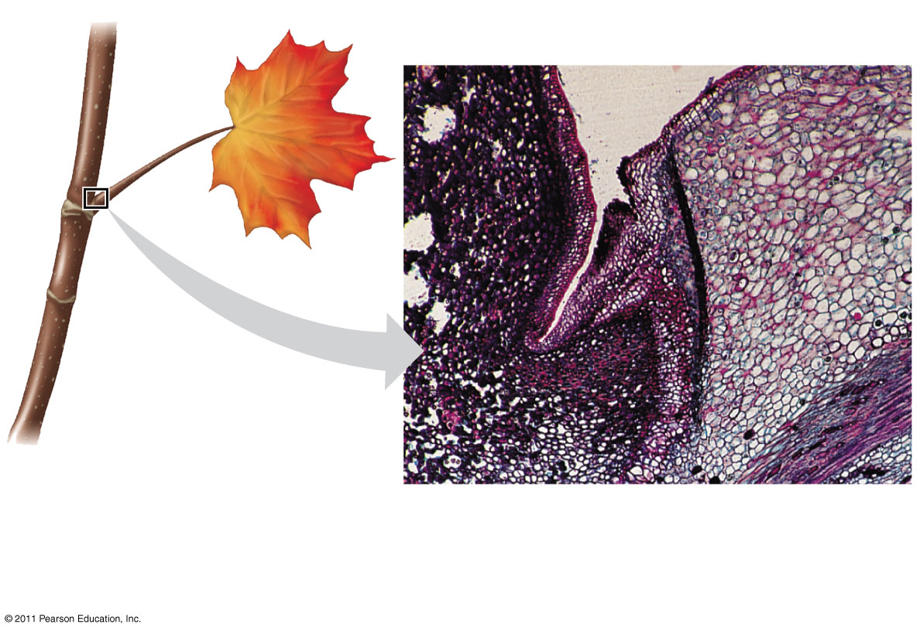
Figure 39.15
0.5 mm
Protective layer
Abscission layer
Stem
Petiole
Notes:
Figure 39.15 Abscission of a maple leaf.

Slide 55
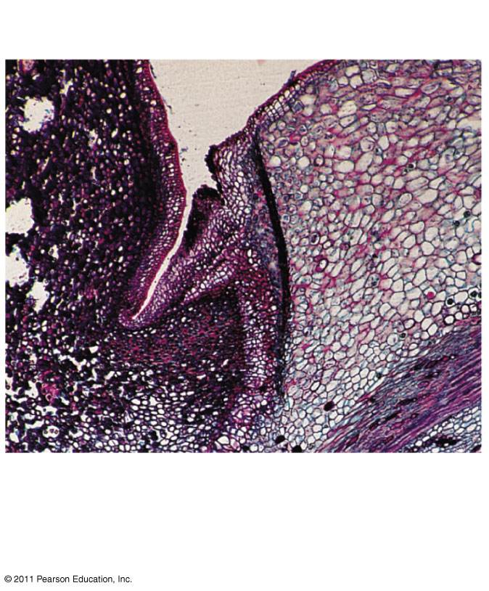
Figure 39.15a
0.5 mm
Protective layer
Abscission layer
Stem
Petiole
Notes:
Figure 39.15 Abscission of a maple leaf.

Slide 56
Fruit Ripening
A burst of ethylene production in a fruit triggers the ripening process
Ethylene triggers ripening, and ripening triggers release of more ethylene
Fruit producers can control ripening by picking green fruit and controlling ethylene levels
© 2011 Pearson Education, Inc.

Slide 57
Systems Biology and Hormone Interactions
Interactions between hormones and signal transduction pathways make it hard to predict how genetic manipulation will affect a plant
Systems biology seeks a comprehensive understanding that permits modeling of plant functions
© 2011 Pearson Education, Inc.

